Slide 1
Intonation in Australian languages
Janet Fletcher
School of Languages and Linguistics
University of Melbourne

Slide 2
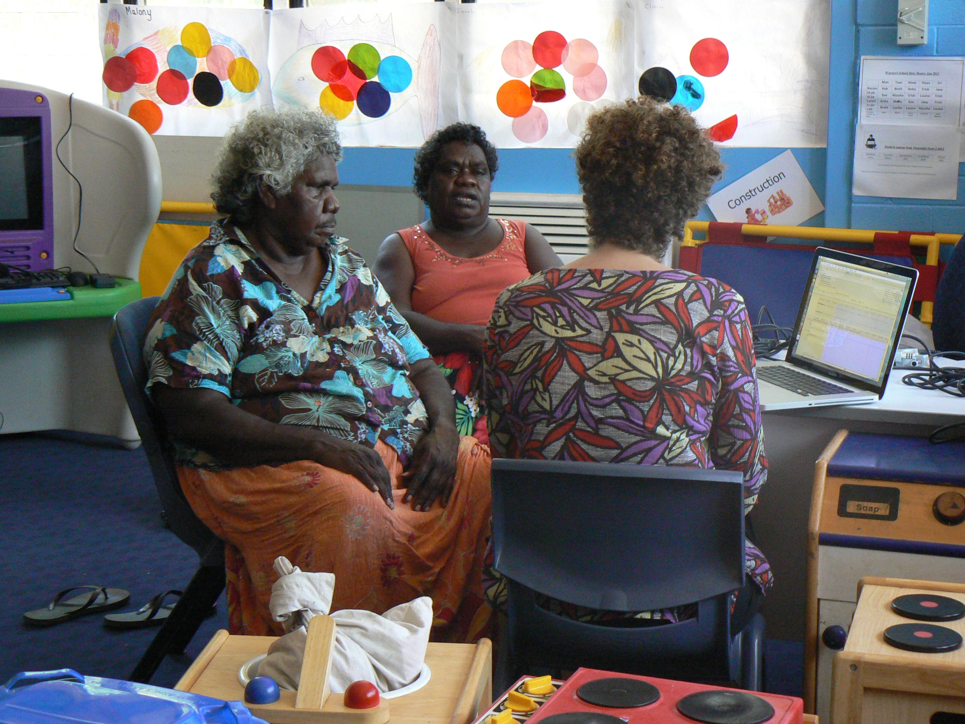
Overview
Intonational characteristics of a group of Australian indigenous languages (mainly Northern Australian languages)
Nita, Nancy, and Ruth,
Goulburn Island, NT

Slide 3
Why is it useful to know about intonation in Australian languages?
Many descriptions of intonation are based on handful of well-studied languages – English, German, Japanese etc.
Need to understand less-well described languages to test and refine our understanding of how intonation works across a range of languages
Notes:
Need to outline the universalist view

Slide 4
Australian Aboriginal Languages
Before 1788
  200-250 distinct languages
Present day
  70 languages
  fewer than 10 have > 1,000 speakers
  most have < 50 speakers
  20 languages or less being transmitted to next generation
  Kriol, a “mixed language”, is often spoken
  Speakers are often multi-lingual

Slide 5
A bit of background
2006 Census:
  455,000 Australians identified as indigenous
  47,000 Australians (12 % of the indigenous population) claimed to speak an Aboriginal language

Slide 6

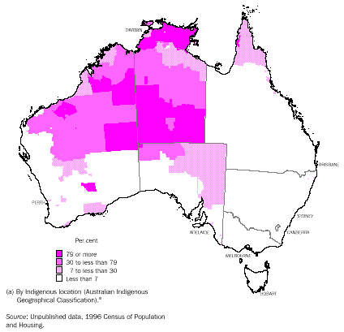
Some of the languages…
Bininj Gun-wok
> 1000
Iwaidja
<150
Mawng
300
Dalabon is almost gone.
Bininj Gun-wok (Kunwinjku variety) is healthy.
Mawng is still being acquired.
Iwaidja is declining…
Dalabon
<5
Warlpiri
3000
Pitjantjatjara
3000
Arrernte
2000
(map courtesy of A. Butcher, Flinders University)

Slide 7
Here are some examples
Dalabon, Eastern Arnhem Land
Bininj Gun-wok (Kundedjnjenghmi variety),
Eastern Arnhem Land
Mawng, Goulburn Island

Slide 8
What does intonation contribute to spoken communication?
Sentence Modality e.g. question versus statement
Phrasing, discourse segmentation – “chunking” for ease of processing
Grammar of Focus marking; pragmatics – “what information is highlighted by intonation?”
Speaker attitude, emotion, etc.

Slide 9
Analysing Intonation – AUTOSEGMENTAL METRICAL MODELS
Tone Target Model – intonation patterns are broken down into sequences of tones, L (low) H (high)
pitch accents, phrase & boundary tones – these define the intonational phrase in English and German

Slide 10
Accented versus Unaccented Words
Words can be accented or unaccented in an intonational phrase
An extra PITCH movement or TONE TARGET makes one word stand out from surrounding words
PITCH ACCENTS

Slide 11
Autosegmental Metrical Models - Pitch Accents
Pitch accents – a tone or tone sequence or pitch shape aligning with primary stressed syllable of words in English or German T* = accent
Different pitch shapes occur on primary stressed syllables of accented words to make them stand out from surrounding words
H* (high) L* (low)
L+H* (rising) L*+H (“delayed rising or scooped”)
H*+L H+L* (“late falling”, “early falling”)

Slide 12
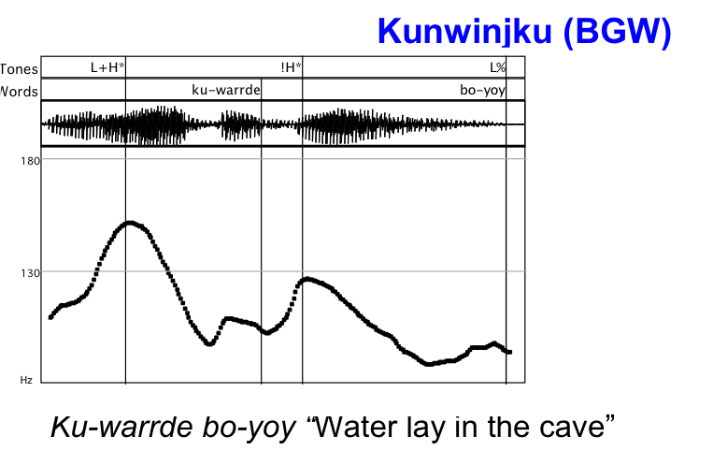
An example from an Australian Language
Pitch Accent
Pitch Accent

Slide 13
Marking intonation boundaries
Intonation phrase – the part of an utterance over which a particular intonation pattern extends (may be one or more in an English or German sentence)
Largest intonational constituent
BOUNDARY tone defines the right EDGE of Intonational Phrase
Usually marked with % e.g. L% H%

Slide 14
Marking intonation boundaries
Intermediate phrase
smaller intonational constituent usually marked with - e.g L- H-
PHRASE tone defines EDGE of Intermediate phrase
German, English combine two tones to mark Intonational Phrase boundaries e.g. L-L%, H-H%, L-H%

Slide 15
Summary of Diacritics
H L (Relatively) High or Low tone target relative to pitch range for that intonational phrase
* after the tone target denotes a H* or L* pitch accent, +H or L+ either side of the * tone target indicates a BITONAL accent
– after the tone target denotes a H- or L- phrase accent or phrase tone, describes the pitch after the nuclear pitch accent (the last accent in a phrase)
% after the tone target denotes a H% or L% boundary tone; marks the final phonetic value of an intonational phrase as relatively High or Low

Slide 16
An example from an Australian Language
L+H*
!H*
L%

Slide 17
Do all languages have the same intonation structure?
Do all intonation languages have pitch accents?
No, some only have phrase tones or boundary tones that mark the edges of chunks of speech and no pitch accents

Slide 18
A Prosodic Typology (Jun 2014)
Does a language have lexical stress, tone/lexical pitch accent, both,or neither at the word level?
WORD
2. Is Sentence level prosodic prominence marked at the HEAD of the phrase?
Is it marked at the EDGE of the phrase?
Is it marked both at the EDGE/HEAD?
    PHRASE
Notes:
Based on Beckman 2006

Slide 19
Three kinds of languages – post-lexical prosody (Jun 2014)
Head-marking prosody, e.g. English, German, Dutch
Edge-marking prosody e.g. French, Korean
Head & Edge marking prosody e.g. Japanese
Notes:
Based on Beckman 2006

Slide 20
Three languages – Informational focus
English (and German)
Pitch accents, Phrase and Boundary TONES
Phrase/Boundary TONES
Korean
Japanese?
from Ueyama & Jun 1998

Slide 21
What are we trying to find out?
Challenge 1: What are the characteristic intonational “tunes” or melodies of Australian languages?
Challenge 2: What is the intonational typology of Australian languages relative to other languages of the world?
Are Australian languages Head-marking, Edge-marking, or Head- and Edge- marking?
Challenge 3: What functions do tunes have in Australian languages?

Slide 22
Australian Indigenous Languages
Typical and (atypical) tunes of Australian languages

Slide 23
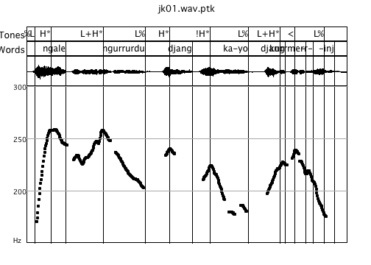
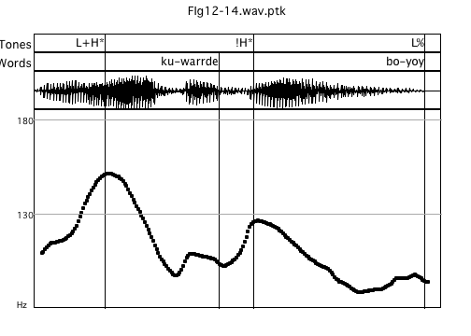
Falling tunes
Kundjedjedmi (BGW)
Kunwinjku (BGW)
Ngale ngurrurdu djang ka-yo djang-kurrme-rr-inj
Ku-warrde bo-yoy “Water lay in the cave”
“That emu of ours is a dreaming, she put herself in the landscape as a dreaming”
Notes:
Peaky vs flat

Slide 24
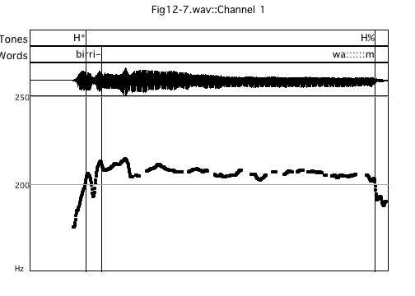
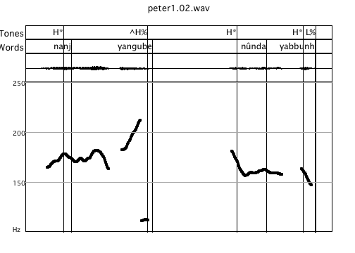
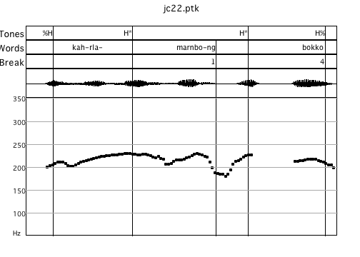
Rising & high level (non-falling) tunes
Rise
Level plateau-like
“(we make a windbreak), over there”
“(he made a spear), he made a hook spear”
Dalabon
Dalabon
“Stylized” high sustained contour – story telling
“They went along……”
Kuninjku
Also, Kayardild (Round 2010), Iwaidja (Birch 2002)
Notes:
Also found in many other languages – Kayardild, iwaidja.. Narrative discourse – contintinuation – time….. Duration of activities etc. – we just stayed there for a long time

Slide 25
Tune types
Not as much variation in tune types that we see in languages like English or German
High falling, High/Mid Level are the major tunes
Fewer tone target categories

Slide 26
Tone Inventory - Mawng
2 basic pitch accent shapes
H* L+H*
Pitch accents | Left-edge boundary tones | Right-edge boundary tones | Right edge Intermediate/ Accentualphrase tones
H* |  | L% | (Lp)
!H* ^H* |  | H% | (Hp)
L+H* |  | LH%
 |  | ^H%
 |  | H:: (Stylized rise)
Boundaries
H% or L%
Hp or Lp
90%
e.g. English Pitch accents H* L* L+H* L*+H H+!H* H*+L,H+L*
German Pitch accents H* L* L*+H H*+L, L+H* H+L*
Notes:
Table woulld be better her.

Slide 27
Transcribing Intonation in Mawng
Intonational Phrase
Pitch accent
H*, L+H*
Pitch accent
H*, L+H*
Boundary tone
L%, LH%, H%
Phrase tone
Lp, Hp
Intermediate (“Accentual”) Phrase

Slide 28
What kind of typology?
Are they Head-marking?
Edge-marking?
Head/Edge-marking?

Slide 29
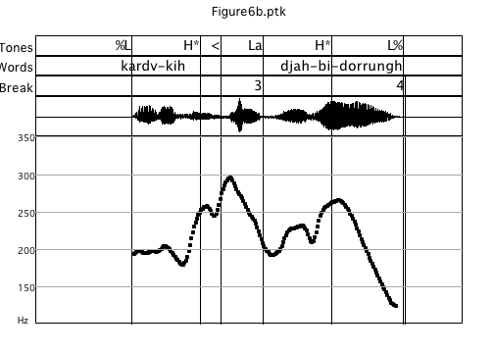
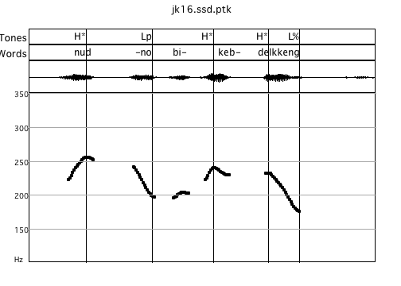
Stress-accent?
What do the Pitch Accents align to?
Pitch accents - first or second syllable of the word in a phrase, often on the stem morpheme, also some prefixes, “stressed” syllable…
Penultimate or final syllable of a phrase-final word
Fletcher & Evans 2002, Bishop 2003, Fletcher 2014
H*
H*
H*
Lp
L%
BGW - Kundedjnjenghmi
H*
H*
%L
Lp
L%
Dalabon – no accent on prefix
Notes:
Variation in the Northern Languages e.g. there can be an unaccented stretch of two syllables before the first H pitch accent

Slide 30
Boundary Tones and pitch range modification
Boundary tones mark the right edge together with pitch accents
Prevalence of “Hat pattern” in many languages
H* H*
L%
Kundjedjedmi (BGW)
Pitch range
Downstep !
Final Lowering
Pitch range reset
H*
L+H*
H*
L+H*
L%
!H*
L%
L%
“That emu of ours is a dreaming, she put herself in the landscape as a dreaming”

Slide 31
Importance of Edges?
Intonational Phrases often align with a single grammatical word made up of many morphemes (mildly – highly polysynthetic languages)
words can be up to 12 morphemes long in Bininj Gun-wok!!
Broken into smaller prosodic constituents
Notes:
Say something here about numbers. Also remind people about what defines a phrase

Slide 32
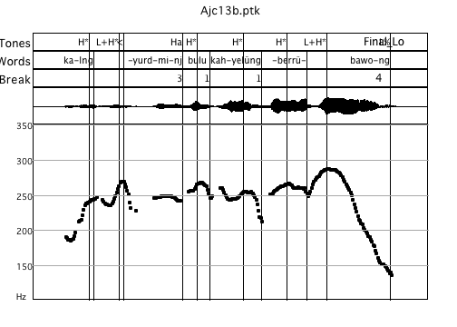
Dalabon – multi-verb Intonational Phrase
ka-lng-yurdmi-nj bulu ka-h-yelûng-berrû-bawo-ng ...
3SG-SEQ-run-PP them 3SG-R-SEQ-many-leave-PP
‘He ran away then and left them all.’
(Fletcher 2014, Ross 2011)
Notes:
Also found in Bininj Gun-wok in a number of languages - large amounts of information can be packed into a single intonational phrase.

Slide 33
What kind of typology?
Head-marking
Edge-marking
Head/Edge-marking
Why?
You can’t just accent any word in a phrase, unlike English
Accents can shift 1-2 syllables into an IP, e.g. possible to have initial unccented stretch of 2-3 syllables, but pitch accents stay relatively close to edges; certain morphemes attract accents

Slide 34
What does intonation do?
Tune and sentence modality
Is there question versus statement intonation?
Statements tend to either have falling intonation or mid-level, dipping intonation (for continuation)
H*
H*
H%
L%

Slide 35
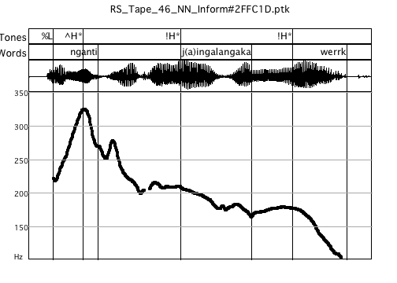
“Wh” -Question words - Mawng
Questions – expanded pitch range of first word
Pitch compression & strong pitch downdrift on rest of sentence but no loss of auditory prominence on final word for example
L+H*
!H*
Lp
H*
L%
Question word
“Who is the one that she sent first?”
Notes:
Need pitch range comparison here.

Slide 36
Interrogative intonation in Mawng
Question word is often first in the utterance (not unusual in the world’s languages!)
Location of the highest pitch peak, pitch downdrift or compression through rest of the phrase
Similar pattern is realised without question word

Slide 37
Interrogative intonation in Mawng
Are there ever question rises?
Yes, in Warlpiri, Ngalagkan, Murrinh-patha
People don’t ask a lot of yes/no questions!!
Rising intonation is not so prevalent
Possibly leads to intercultural communication problems…..

Slide 38
Information Structure - Focus
How do Australian languages use intonation to highlight important information in connected speech?

Slide 39
Two general intonation strategies – information structure
New/salient information: pitch accents on some kind of constituent
Local pitch range or register reset at the beginning of intonational phrases
Suspension of global pitch downtrends
Modification of prosodic structure can give insights on the nature of prosodic typology

Slide 40
An example of “contrastive” focus in English
(in response to “ Do you have a galah open cut mine?”
(No I’ve gotta DINGO open cut mine).
Early nuclear accent – DINGO vs GALAH open cut mine “contrastive focus”
Long unaccented stretch of speech after nuclear accent
H+ !H*
L-L%

Slide 41
Word order
Australian - ‘free word order’
Putting a word into initial position - focus (or discourse prominence) in a large number of Australian languages (Baker and Mushin 2008)

Slide 42
Focus in Australian Languages
Rising pitch accent shape L+H* anchored to the focused word or very high H*
Intonational phrasing – focused element is also often realized as its own intonational phrase
Pitch range expansion on the focused word
No de-accenting of following material - pitch accents remain but overall pitch range after the highlighted element is reduced, compressed

Slide 43
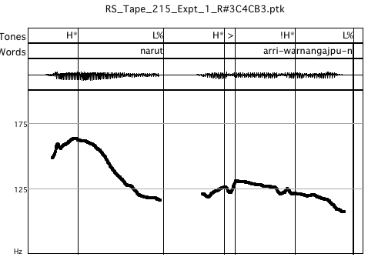
Mawng “contrastive” focus
Speaker RM
Fronted target word (object) realised with expanded pitch range
“contrastive focus”
Separate Intonational Phrase
Verb - compressed pitch range but pitch accents remain – separate Intonational phrase
IP1
IP2
(We don’t call it puffer fish)
Narut arri-warnangajpu-n
“We call it Sturgeon fish”

Slide 44
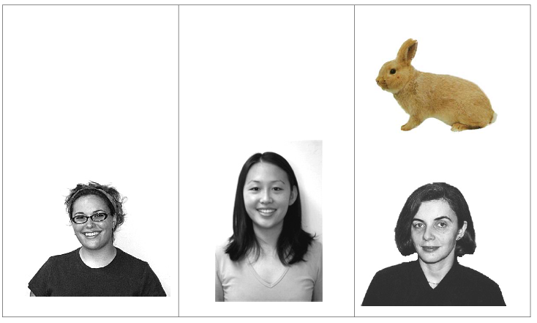
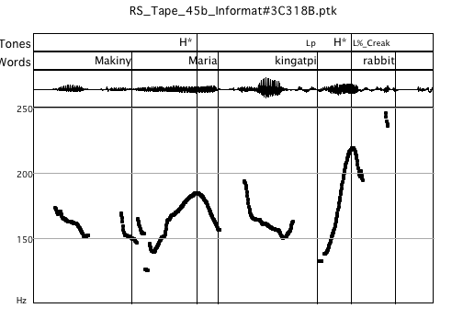
What if you want to highlight the final word?
Speaker NN
L+H*
L+H*
!H*
Pitch range boosting + prosodic phrasing
Lp
Question: Kurlingka Maria k-ing-atpi-ø rabbit or karlarrk?
Does Maria have a rabbit or a cat?
Answer: Makiny, Maria k-ing-atpi-ø rabbit. (see pitch trace above)
No, Maria has a rabbit.

Slide 45
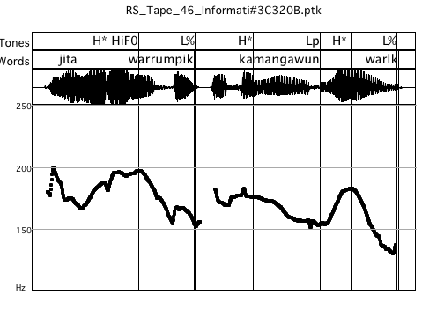
What if you want to highlight the final word?
Speaker SB
L%
insertion of a minor phrase boundary between last two words
Subject also realised in own IP
(Question: Is the woman hitting the man?)
Answer: Jita warrumpik kamanga-w-un warlk
The woman is hitting the tree.

Slide 46
Intonation in Australian Languages
Fewer “tones” i.e. fewer intonational pitch accent shapes compared to Germanic languages, e.g. German, Dutch, English; fewer complex intonational conours
Importance of intonational phrasing and pitch range manipulation to signal a range of “traditional” functions associated with intonation

Slide 47
Acknowledgements
Our language consultants
Nick Evans, Ruth Singer, Marija Tabain, Andy Butcher, Debbie Loakes, Hywel Stoakes, Simone Graetzer, Anna Parsons
Australian Research Council and University of Melbourne

Slide 48
References & Bibliography
Baker, Brett & Ilana Mushin (2008). Discourse and grammar in Australian languages. In Mushin, Ilana & Brett Baker (eds.) Discourse and grammar in Australian languages. Amsterdam: John Benjamins. 1-24.
Beckman, M. & Venditti, J. 2010. Tone and Intonation. In. W.Hardcastle et al. (eds.) Handbook of the Phonetic Sciences (2nd ed). Wiley-Blackwell
Beckman, M. et al. (2005). The original ToBI system and the evolution of the ToBI framework. In S-Jun (ed.) Prosodic Typology: The phonology of intonation and phrasing. Oxford:OUP
Birch, B. 2002. The IP as domain of syllabification. Proceedings of the 1st International Conference on Speech Prosody, B. Bel and I. Marlien, Eds. Aix-en-Provence: Laboratoire Parole at Langage, 2002
Bishop, J. 2003. Aspects of prosody and intonation in Bininj Gun-wok. PhD thesis (available online through the University of Melbourne e-prints repository)
Bishop, J. and Fletcher 2005. Intonation in six dialects of Bininj Gun-wok. In Jun S-A. Prosodic Typology, Oxford:OUP
Butcher, A. (2006).
Bruce, G. (1977). Swedish word accents in sentence perspective. Lund: CWK Gleerup.
Fitzpatrick, J. (2000) On intonational typology. In Peter Siemund (ed.) Methodological Issues in Language Typology. Sprachtypologie und Universalienforschung 53: 88-96.

Slide 49
References & Bibliography
Fletcher J. (2014). Intonation in Dalabon, in. S-A. Jun (ed.) Prosodic Typology II, Oxford:OUP
Fletcher J. 2005. Exploring the Phonetics of Spoken Narratives in Australian Indigenous Languages. In Hardcastle WJ & Mackenzie Beck J (eds), A Figure of Speech: A Festschrift for John Laver. New Jersey, United States: Lawrence Erlbaum Associates, pp. 201-226.
Fletcher, J. and Evans N. 2000. Intonational downtrends in Mayali. AJL 20, 23-38.
Fletcher, J. and Evans N. 2002. An acoustic phonetic analysis of intonational prominence in two Australian languages, JIPA 32, 123–40.
Fletcher, J., Stoakes, H., Loakes, D., Butcher A. 2007, Spectral and durational properties of vowels in Kunwinjku. Proceedings of the 16th International Congress of Phonetic Sciences. 937-940. SAARBRUCKEN, Germany: UNIVERSITY OF SAARLAND.
Fletcher J, Butcher A, Loakes D, & Stoakes H. (2010). Aspects of nasal realization and the place of articulation imperative in Bininj Gun-Wok. In Tabain M. et al. (eds), Proceedings SST2010, 78-81. Melbourne, Australia: Australasian Speech Science and Technology Australia (ASSTA).
Fletcher, J., N. Evans, and E. Round, (2002).Left-Edge tonal events inKayardild (Australian): a typological perspective. Proceedings of the 1st International Conference on Speech Prosody, B. Bel and I. Marlien, Eds. Aix-en-Provence: Laboratoire Parole at Langage, 2002, pp. 295-298.

Slide 50
References & Bibliography
Fletcher, J., Singer, R., Loakes, D. (2012). Intonation and focus-marking strategies in Mawng. Tone and Intonation in Europe 5. Oxford, September 2012.
Hale, Kenneth (1983). Warlpiri and the grammar of non-configurational languages. Natural language and linguistic theory 1: 5-47.
Hualde, J. (2006). Remarks on word-prosodic typology. Proceedings of the Berkeley Linguistics Society, 32
King, H. (1998). The declarative intonation of Dyirbal. Lincom Europa
Gussenhoven, C. (2004). The phonology of tone and Intonation. Cambridge:CUP
Ladd, D.R. (2008). Intonational phonology. Cambridge:CUP
Pierrehumbert, J.(1980): The Phonology and Phonetics of English Intonation. Ph.D. dissertation, MIT.
Pierrehumbert, J. & Hirschberg, J.(1990): The meaning of intonational contours in the interpretation of discourse, in: Cohen, P. R. el al.(eds.), Intentions and Communication, Cambridge: MIT Press. 271–311.
Ross, B. (2011). Prosody and grammar in Dalabon and Kayardild. PhD thesis, University of Melbourne (available through UniMelb e-prints)

Slide 51
References
Ross, B., Fletcher,J. & Nordlinger (in press.). Intonation and grammatical structure in Dalabon, Australian Journal of Linguistics
Round, E. (2010). Tone height binarity and register in intonation:the case from Kayardild (Australian). Proceedings of Speech Prosody 2010
Simard, Candide (2010). The Prosodic Contours of Jaminjung, a Language of Northern Australia. Manchester: University of Manchester PhD.

