Slide 1
What is an agent-based model and is it helpful in understanding sound change?
Jonathan Harrington

Slide 2
The IP model of sound change
The IPS has developed in the last few years a cognitively inspired, computational model sometimes known since [2] as the Interactive Phonetic (IP) model of sound change¹⁻¹⁰.
1. Harrington, J. & Schiel, F. (2017, Language)
2. Harrington, J., Kleber, F., Reubold, U., Schiel, F., & Stevens, M. (2018, Top. Cog. Science)
3. Stevens, M., Harrington, J., and Schiel, F. (2019, Glossa)
4. Harrington, J., Gubian, M., Stevens, M., and Schiel, F. (2019, J. Acoustical Soc. America).
5. Stevens, M. & Harrington, J. (2022, Glossa).
6. Cronenberg, Klingler, Kleber, Pucher (2022, Interspeech)
7. Gubian, M., Cronenberg, J., and Harrington, J. (2023, Speech Communication).
8. Cronenberg, J. (2024, doct. diss.)
9. Jochim, M. & Kleber, F. (2025, in press: in Rathcke & Kleber eds. )
10. Kapia, L. & Riverin-Coutlée, J. (in press, in Omari A., A, Sinani, L. Halala eds. )
Media attention due to [4] – see here and especially here
Recent review by Beddor (2023, section 5.2)

Slide 3
The IP model of sound change
has, as one of its main purposes, to understand how the phonetic origin and phonetic spread of sound change are connected.
Phonetic origin
The phonetic conditions likely to lead to sound change.
Spread of sound change
How such conditions come to 'infect' an entire speech community over time.

Slide 4
The IP model of sound change: foundations
Phonetics and sound change
1. sound change is directional (Garrett & Johnson, 2013)
2. there is a link between the direction of phonetic variation and sound change (Harrington & Schiel, 2017).
Spoken language interaction
3. Perceived speech influences speech production (e.g., Pierrehumbert, 2003) through selective memorization.
4. Selective memorization can under certain circumstances bring about sound change over time.

Slide 5
1. Sound change is directional
X > Y does not imply Y > X with equal frequency¹
s-retraction (but rarely ʃ-fronting)
k > tʃ, but never tʃ > k
u-fronting (but rarely i-backing)
Directional sound change has a synchronic, phonetic origin:
s-retraction²
ki → ti perceptual confusions^{3.}
u-fronting (various)
1. garrett2011.pdf. 2. Stevens et al, 2015; Stevens & Harrington, 2016. 3. guion1998.phonetica.pdf; ohala1992.pdf

Slide 6
2. The direction of phonetic variation and sound change
According to the IP-model of sound change¹, phonetic variation is directed along a possible path of sound change.
AP 2
u > ʉ > y
3
B
A
Acoustic parameter (AP) 1
A
B
A and B are two speakers (or speaker groups) producing retracted (A) and fronted (B) variants of /u/ at earlier and later stages of a sound change.
1. Harrington, Kleber, Reubold, Schiel, Stevens (2018).

Slide 7
3. Perception influences production: selective memorization
Memory
Auditory space
Production
who
Perception
who
who
soon
move
soon
move
soon
soon
move
move
Selectively add to memory based on typicality.
/u/
Acoustic signal of 'who'
Acoustic signal of 'who'
1. Todd, Pierrehumbert, and Hay (2019, Cognition)

Slide 8
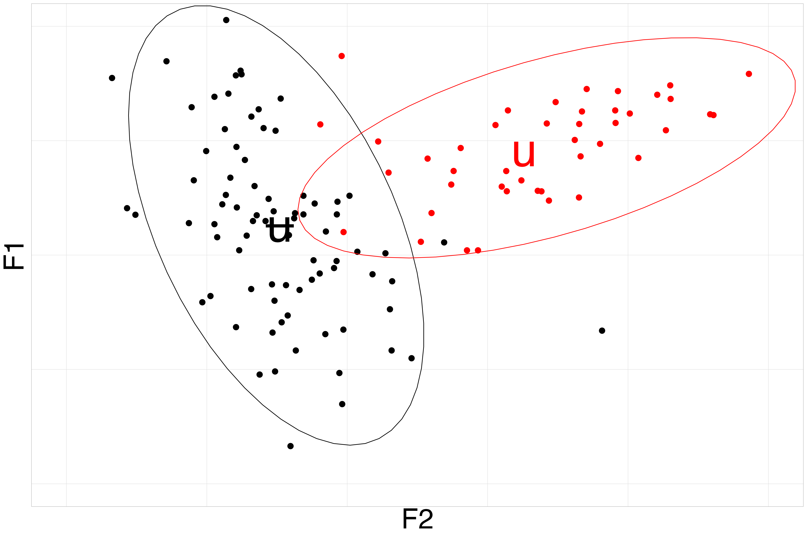
3. Selective memorization through typicality
Innovative individual: fronted [ʉ]
Any points within the confidence ellipses are typical and can be memorized.
Conservative individual: retracted [u]
More [ʉ] tokens (black points inside the red ellipse) are memorized by the conservative individual because they are typical of [u].

Slide 9
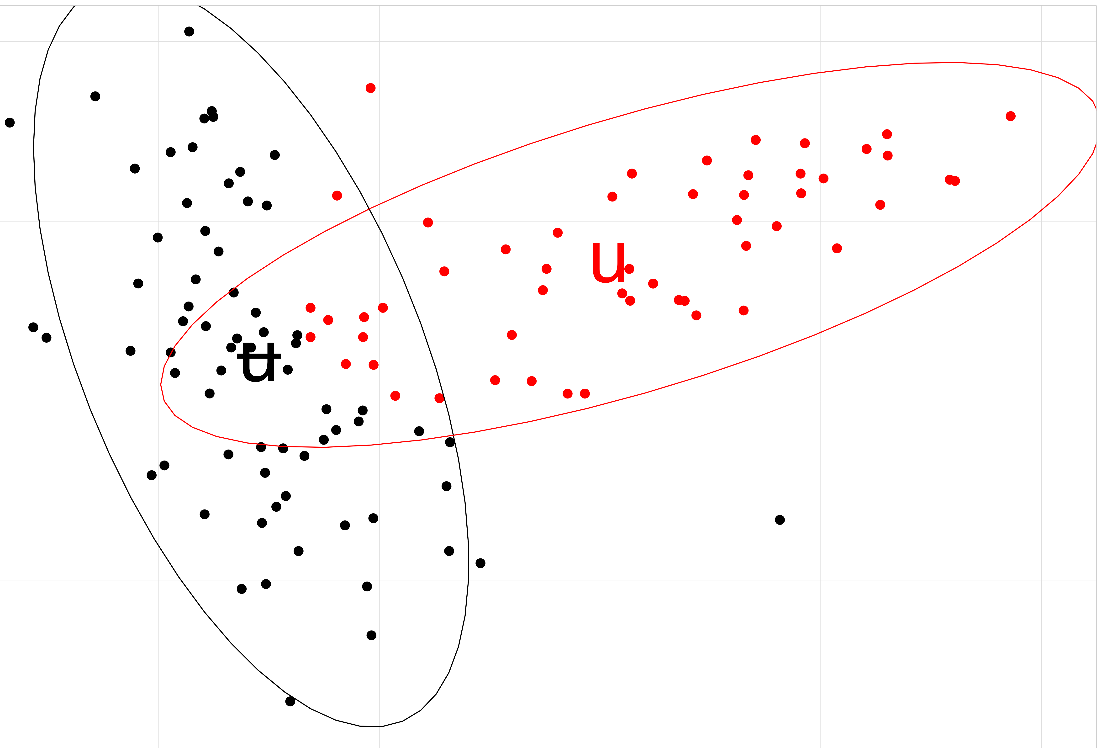
4. Selective memorization and sound change over time.
u > ʉ > y
If:
3
B
A
A
B
then A shifts more towards B than the other way round (= sound change)
selective
memorization

Slide 10
/u/-fronting and agent-based modelling
Sound change path
[u] > [ʉ] > [y]
A
B
A: older speakers with retracted [u]
B: younger speakers with fronted [ʉ]
Hypothesis of IP-model: When A and B speak to each other, then A should shift more towards B than B towards A.

Slide 11
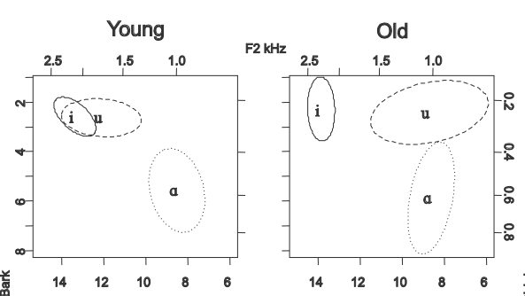
Data for the agent-based model
was taken from Harrington, Kleber, Reubold (2008)

Slide 12
Speakers and materials
27 speakers 14 old (age 69.2 Jahre), 13 young (age 18.9 yrs)
They produced 10 repetitions of 54 isolated words.
For the agent-based model, 11 minimal-pair words × 10 repetitions = 110 productions/speaker were used.
/f/ /s/ /k/ /h/
i feed seep keyed heed
ju feud queued hewed
u food soup cooed who'd

Slide 13
Acoustic parameters: DCT
F2 trajectories were calculated between acoustic onset and offset
The discrete cosine transformation^{1,2} (DCT) was applied to each trajectory to reduce it to a point in a 3D-space.
1. Watson & Harrington (1999, J.Acoustic.Soc.America)
2. See examples in Emu-R

Slide 14
F2-trajectory
DCT-coefficients¹
F2-reconstruction from DCT coefficients
= Amplitudes of ½ cycle cosine waves
C₀ (mean)
F2
F2
C₁ (slope)
Amplitude
C₂ (curvature)
Time
Time
Time
1. See examples in Emu-R

Slide 15
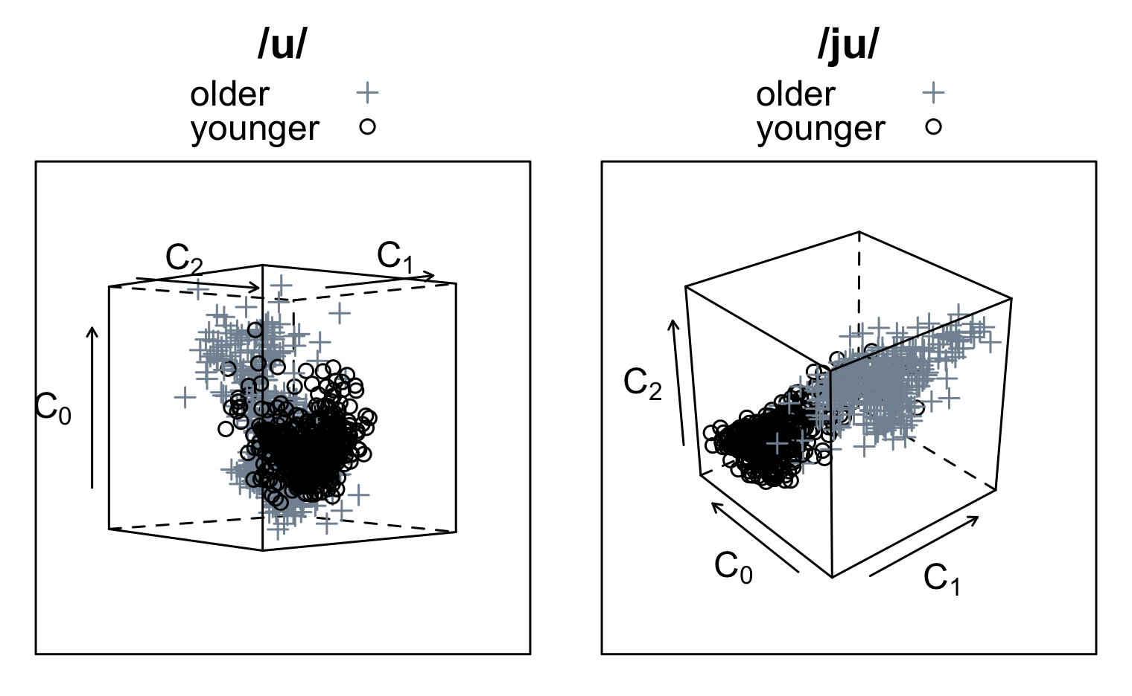
Phonetic variation of old and young
In this 3dim-DCT space, old is directed more towards young than young to old

Slide 16
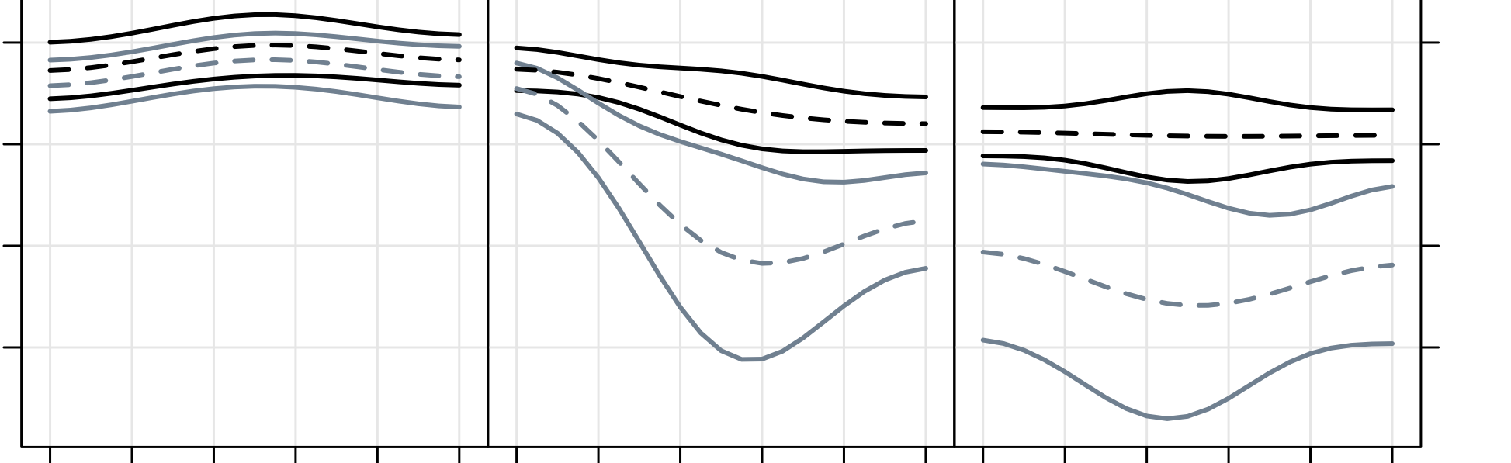
Phonetic variation of old and young
/i/
/ju/
/u/
______ ±2 s.d.
--------
Mean
DCT reconstructed F2
Normalized time

Slide 17


The IP agent-based computational model of sound change
Available as R package soundChangeR (Johanna Cronenberg)
https://github.com/IPS-LMU/soundChangeR
One agent per real talker
Agents can exchange dynamic signals (e.g., a DCT
parameterization of an entire formant trajectory).

Slide 18
Agent-based model: Initialisation
22 agents, 11 old and 11 young (one agent per speaker)
Prior to interaction, each agent had stored in memory:
Word classes (11 soup, seep, food…)
Phonological classes: /i, ju, u/
C₀, C₁, C₂ DCT coefficients
Typically 110 objects per agent
An object had five components: e.g. {seep, /i/, 3 DCT coeffs.}

Slide 19
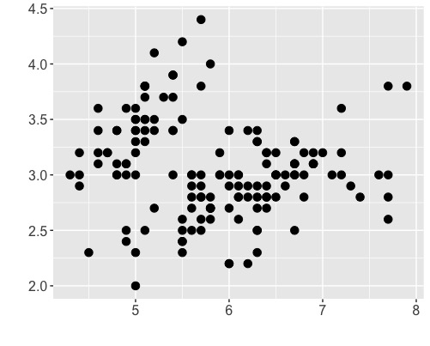
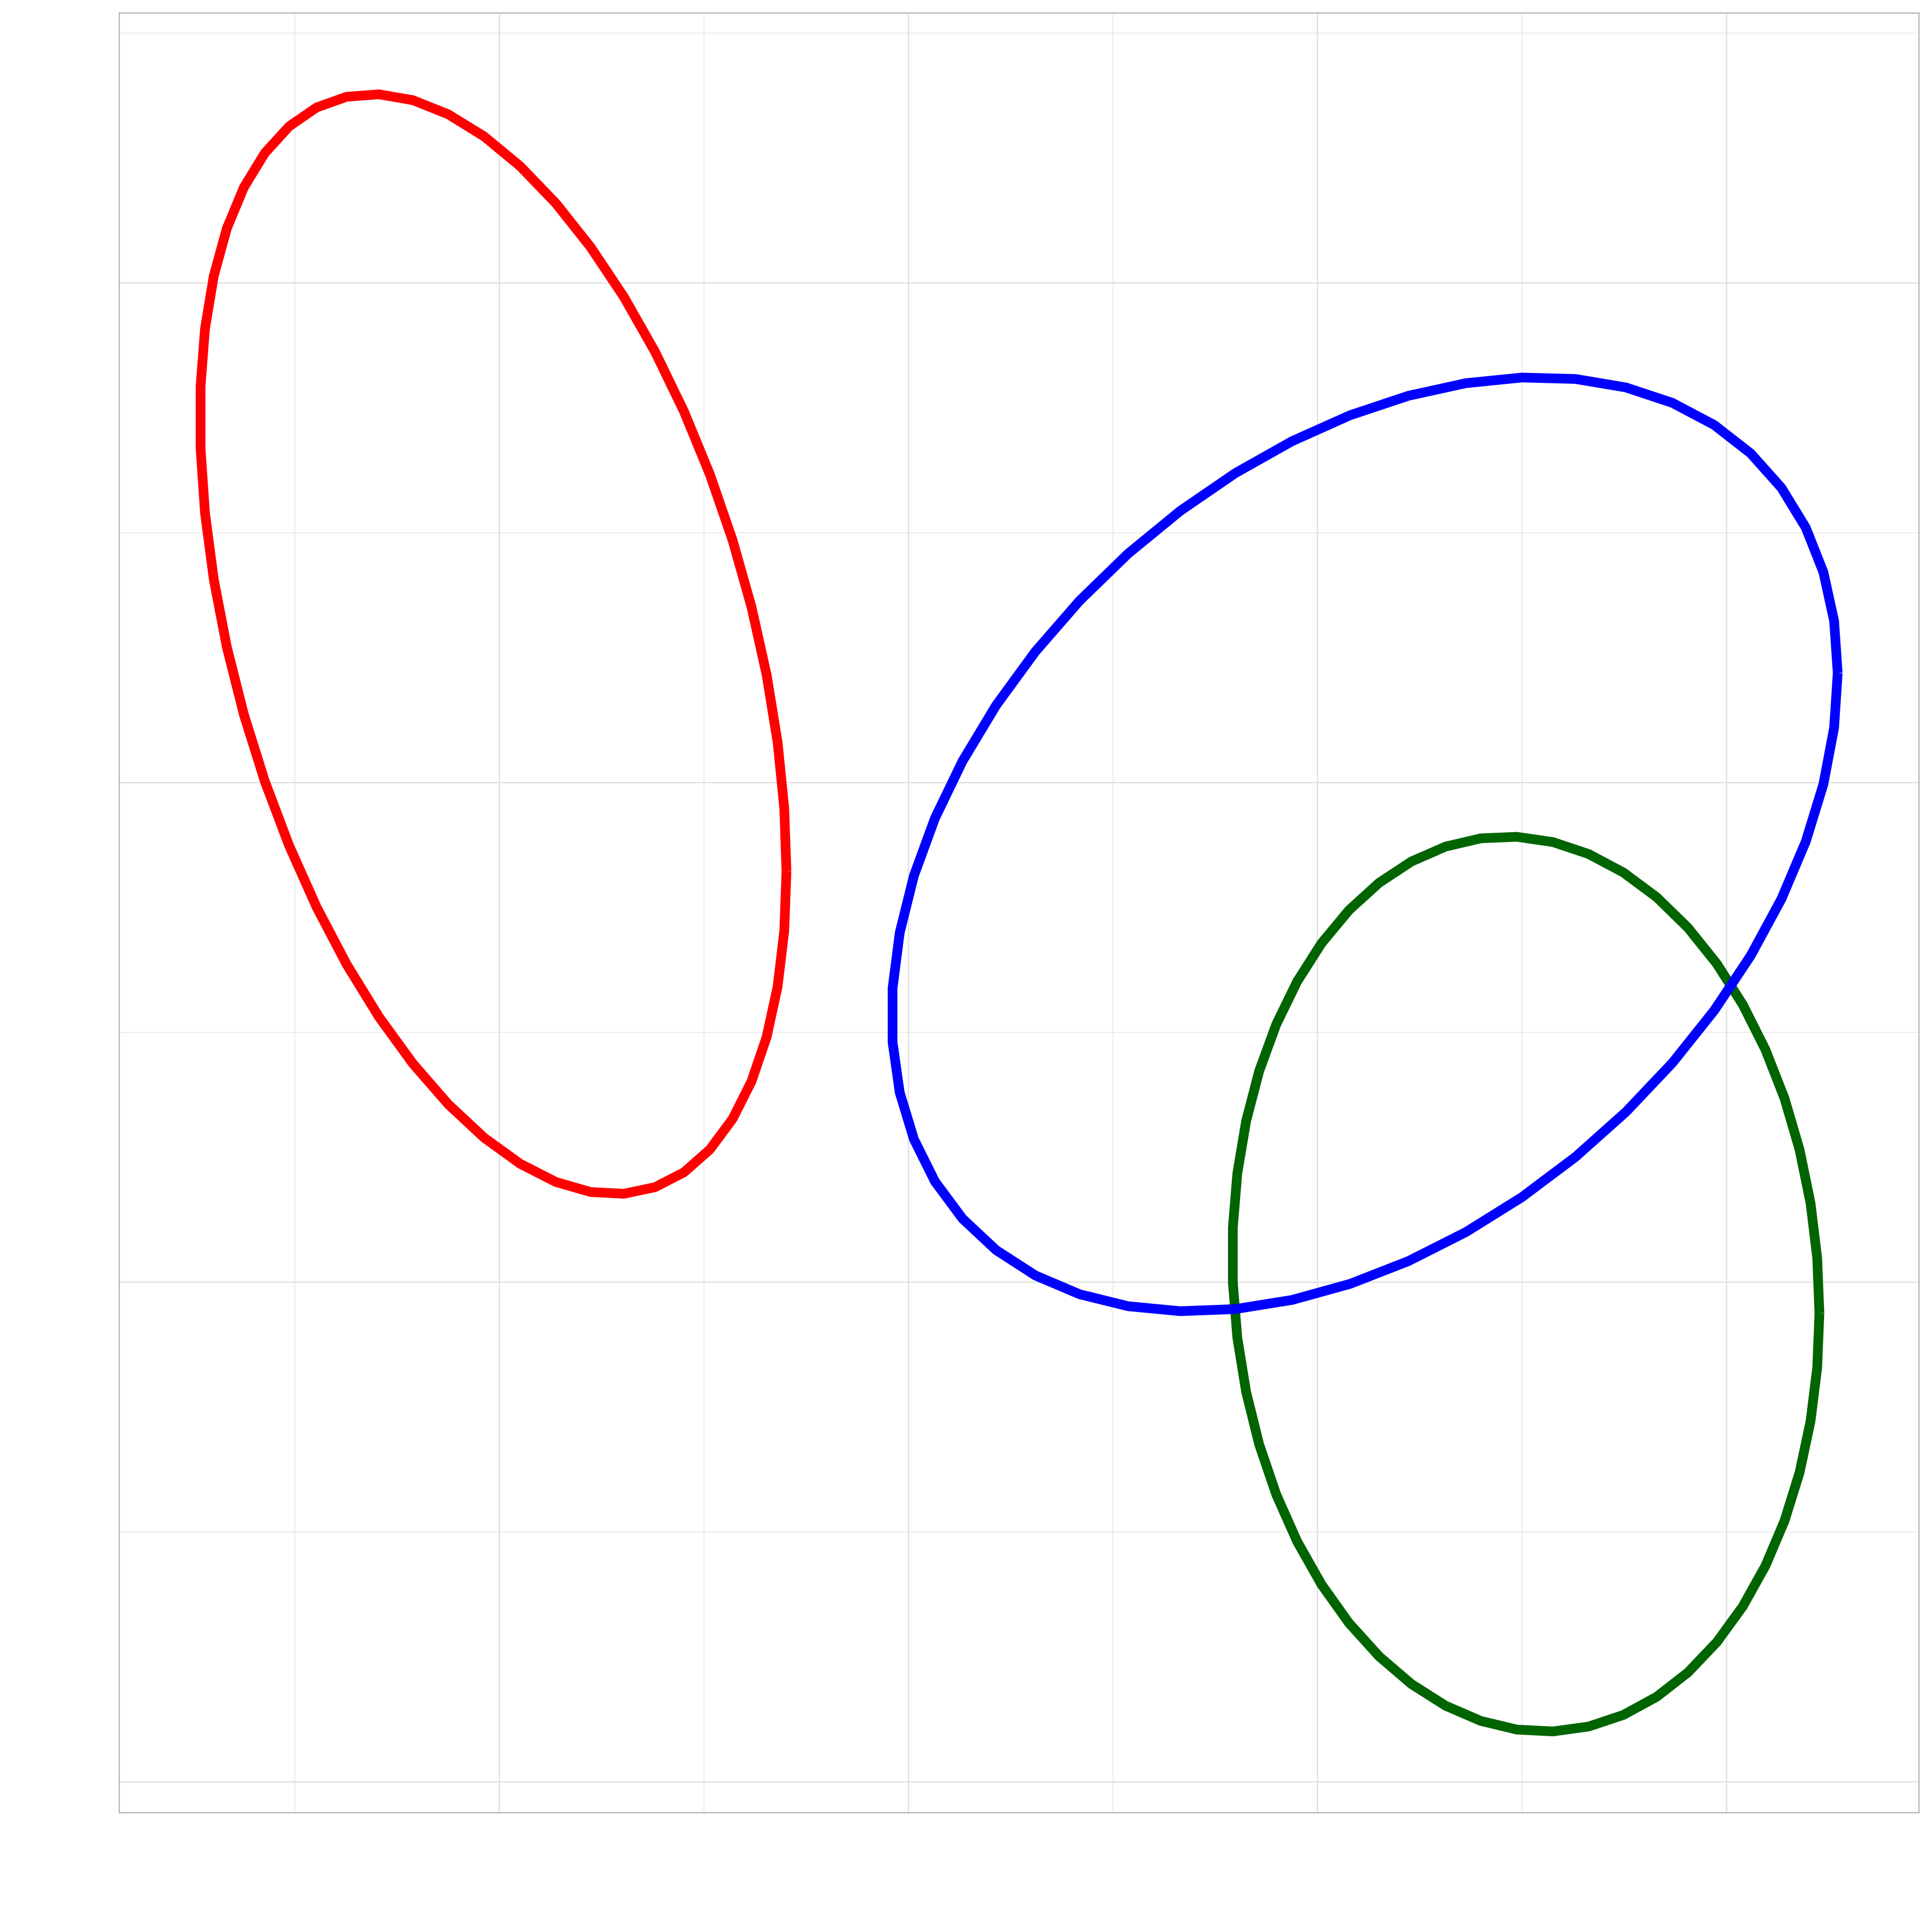
Agent talker
randomly paired
Agent listener
Gaussian model over memorized exemplars of /ju/, /i/, /u/.
Agent listener's decision
1. Random selection of word e.g. food
food
3. Add x as an exemplar of
food to memory, based on typicality and discriminability
to listener's /u/
2. Generate one DCT-triplet x, from a Gaussian model of /u/ formed from all food tokens of that speaker
x
4. If added, randomly remove a food token from memory
For 60,000 interactions

Slide 20
Discriminability
Only memorize a token x of a phonological class P as long as it is not probabilistically closer to any other phonological class.
Discriminability
has no influence on the memorization of phonetic variants of the same phonological class (e.g. [ʉ] and [u] of food or of feud)
preserves the distinction between different phonological classes: that is, it prevents /i, ju, u/ (e.g., feed, feud, food) from merging i.e., collapsing, into a single phonological class).

Slide 21
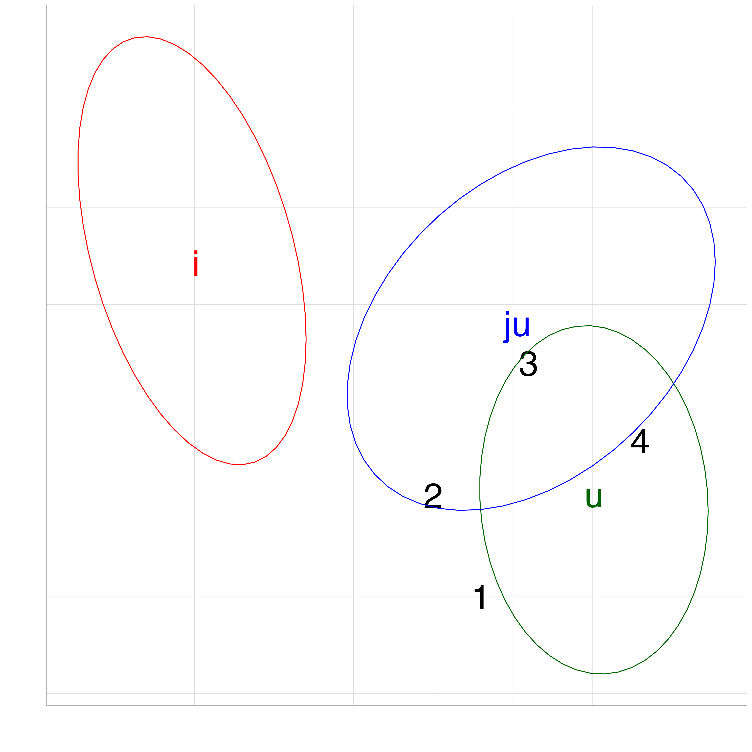
Discriminability and typicality
95% confidence ellipses
1-4 are four tokens of an agent speaker's productions of food.
The ellipses are those of an agent listener's phonological classes.
1 2 3 4
typical - - + +
discriminable + - - +
Only 4 is memorized by the agent listener.

Slide 22
Models that were run and predictions
Three ABMs were run consisting of:
(a) 11 older speakers only
(b) 11 younger speakers only
(c) all 22 speakers
Predictions
(a, b): no change in /ju/ or /u/ because the groups are homogeneous (old: all back [u]; young: all front [ʉ]).
(c): /ju, u/ of old should shift towards young.
(a, b, c): no change in /i/ for which there is hardly any speaker variation.

Slide 23
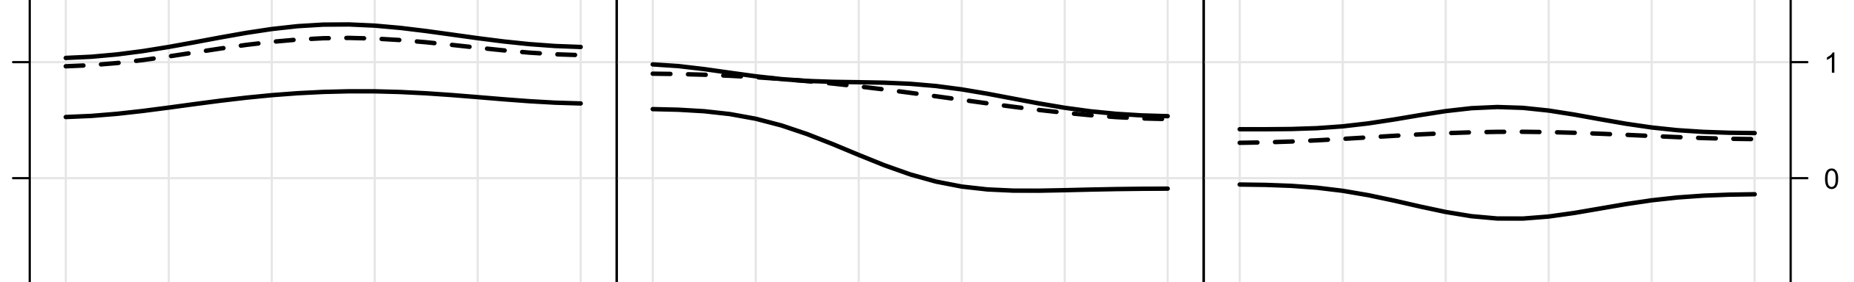
No change within same speaker groups
Young talked to young
_______________ ±2 s.d. of original
(prior to interaction).
/i/
/ju/
/u/
DCT reconstructed F2
Old talked to old
----------------
Mean after 30,000 interactions
Normalized time

Slide 24
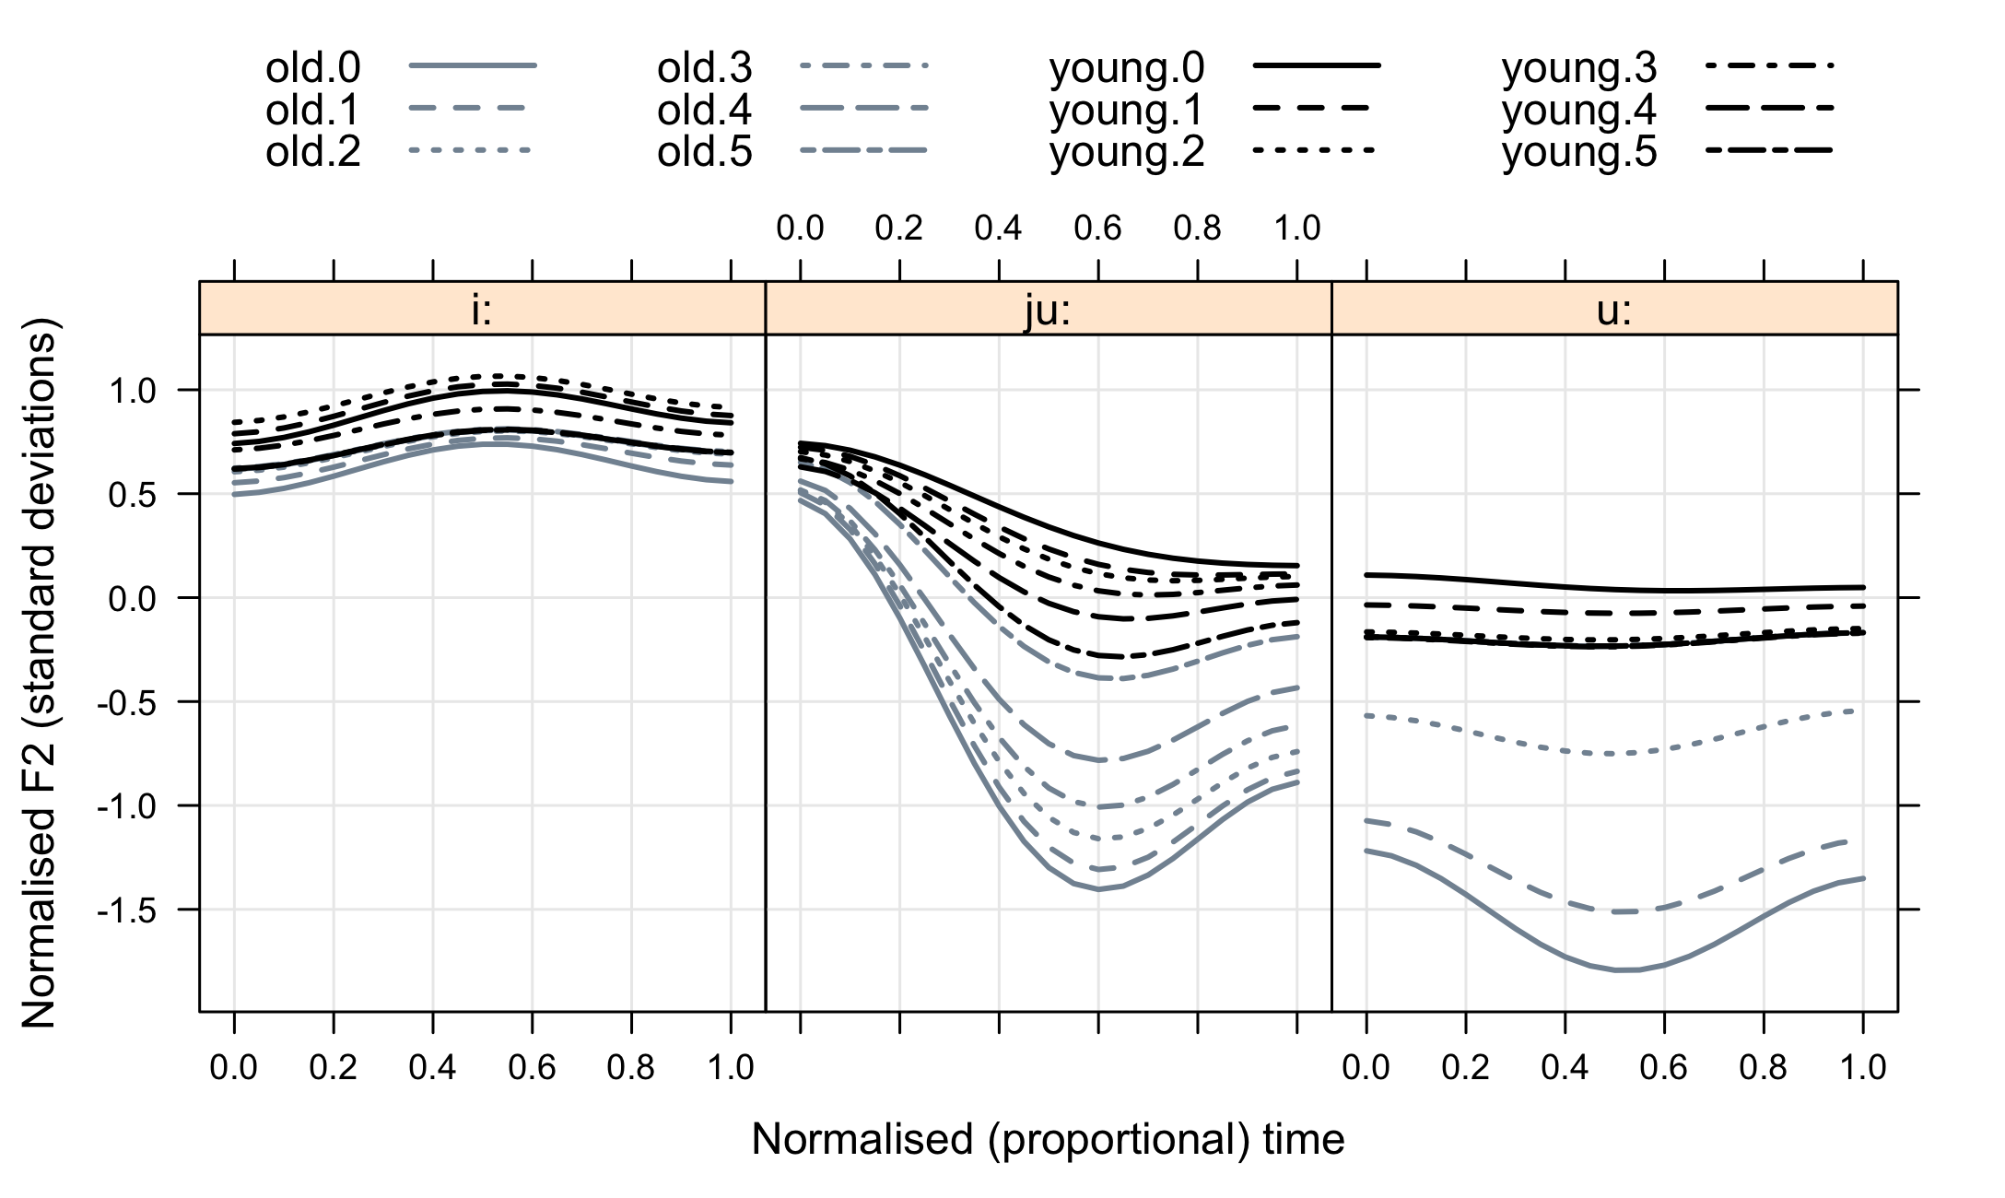
Both groups interact: old → young in /ju, u/
0 = baseline (at start)
old
0..2
old: 3..6
young: 0..2
young: 3..6
1..6 after 10,000 – 60,000 interactions.
DCT reconstructed F2
i
ju
u
Normalized time

Slide 25
Conclusions and outlook
How sound change gets going: there is interaction between (groups of) individuals who are advanced to different degrees along a path of sound change combined with selective memorization.
The model cannot explain how some individuals get to be more 'innovative' than others in the first place.
Sound change is not inevitable if there is relative phonetic homogeneity between individuals.
The model in Harrington & Schiel (2017) cannot handle phonetic mergers (neutralization) because of discriminability – but see [2,3,7] page 2.

