Slide 1
Phonologization, nasalization, and sound change: an MRI analysis of two varieties of English.
Jonathan Harrington, Conceição Cunha, Phil Hoole, Esther Kunay
IPS Munich.
J. Frahm, D. Voit, Max Planck Institute for Multidisciplinary Sciences, Göttingen

Slide 2
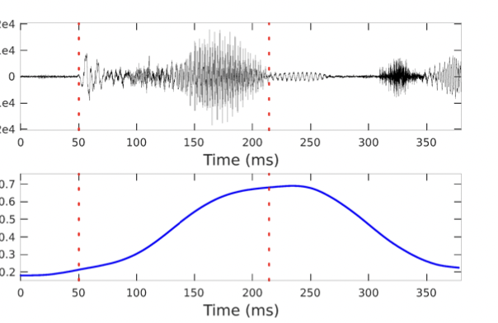
Coarticulatory vowel nasalization in VN
German: Panther
p ^{h} a n t ^{h}
velum opening
VN_{t}
(acoustic boundary between V and N)

Slide 3
Sound change in VN
Lt. sonus
Ital. suono
Vn > Ṽn > Ṽ^{n} > Ṽ
French, Portuguese: /sõ/
Bolognese Italian
VINU > vin > vĩn > vĩ > vẽ > vẽŋ > veŋ
Hajek, 1991¹; Saunders, 1979²:
Chengdu Chinese
Sishi Liao, IPS ³.
an > ãn > ɛ̃n > ɛ
1. Hajek 1991. In Bertinetto, Kenstowicz, Loporcaro; eds. 2. Saunders, 1979. In Hollien & Hollien eds; 3. Liao et al (2022, Interspeech; Liao et al, 2023, Int. Cong. Phon. Sci.

Slide 4


Linking coarticulation and sound change
Work out the mapping between two sets of synchronic data positioned at different points on the diachronic path of sound change.
this study
send
Beddor and colleagues
old
won't work: sound change too slow
Apparent-time
analysis
Vn > Ṽn > Ṽ^{n} > Ṽ
young
sent
1. Beddor (2009, Language). Beddor, McGowan, Boland, Coetzee, Brasher (2013, J. Acoust. Soc. Am). Beddor, Coetzee, Styler, McGowan, Boland (2018, Language)

Slide 5
Sound change less advanced in
?
/n/deletion in sent | Tongue raising in pan beyond [ɛ]
no | no
yes: e.g. Beddor et al (2013) | yes: e.g. Mielke et al (2017)
Vn > Ṽn > Ṽ^{n} > Ṽ

Slide 6
Model of Beddor and colleagues ¹
Findings
More vowel nasalization and shorter /n/ in sent vs. send
Sound change more likely in /nC_{voiceless}/ clusters ( see also Carignan et al, IPS, 2021) ²
Model
An earlier phasing of a stable velum gesture
1. Beddor (2009, Language). Beddor, Beddor, McGowan, Boland, Coetzee, Brasher (2013, J. Acoust. Soc. Am.); Beddor, Coetzee, Styler, McGowan, Boland (2018, Language); Beddor (2023, J. Phon)
2. Carignan et al, (2021) Language

Slide 7
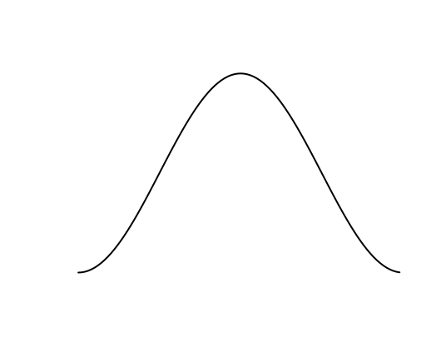
Model of Beddor and colleagues
send
Velum
Tongue dorsum
ɛ
ɛ̃
n
sent
Velum
Tongue dorsum
ɛ
ɛ̃
n

Slide 8
The present study
Does this model work for British (BRE) vs. American English (USE) in the same words (e.g. comparing BRE vs. USE Ben?)
What happens to the oral gesture of N e.g. tongue tip (TT) of /n/ in Ben?¹
According to this:
Vn > Ṽn > Ṽ^{n} > Ṽ
the TT should shorten and lenite as the velum gesture slides to the left (earlier in time)
see also Bongiovanni (2021, J. Labphon; 2021, Ling. Vanguard)

Slide 9
The model to be tested
/VN/ in Ben
Tongue tip
Velum
Tongue dorsum
ɛ
ɛ̃
n
Tongue tip
Velum
Tongue dorsum
ɛ
ɛ̃
n

Slide 10
Speakers
27 speakers (13 F) of standard Southern British median age 20 years, age range 18-46 years.
BRE
16 speakers (7 F) approximately equally distributed between Midland, Northeast, Southern, West, median age 26 years, age range 20-37 years.
USE

Slide 11
Materials
saw <targetword> about two/four/five/six/ten"
47 real word monosyllables formed from CVN(d|z)
C = any of /b, p, f/ rarely /s/. E.g.:
Each word typically repeated once per speaker
Around 2020 tokens from 47 words types × 43 speakers.
 | æ | eɪ | ʌ | ɛ | ɪ
n | ban | feign | bun | Ben | bin
nd | band | feigned | fund | bend | binned
nz | bans | feigns | buns | Ben's | bins

Slide 12
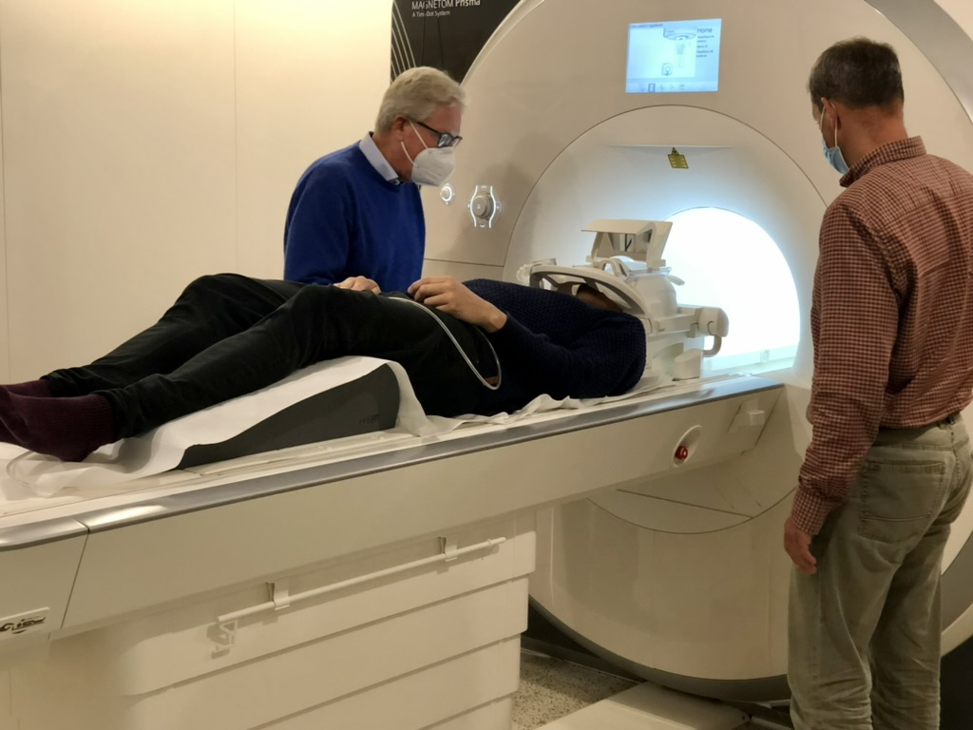
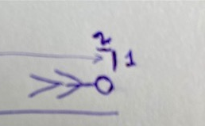
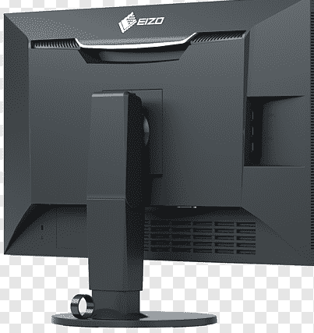
Subject recording
50.05 frames per second. 3T MRI system
External
monitor
with
word list
mirror 1 reflected onto
mirror 2
Fiberoptic microphone

Slide 13
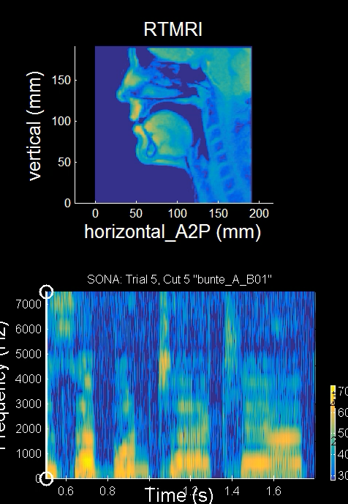
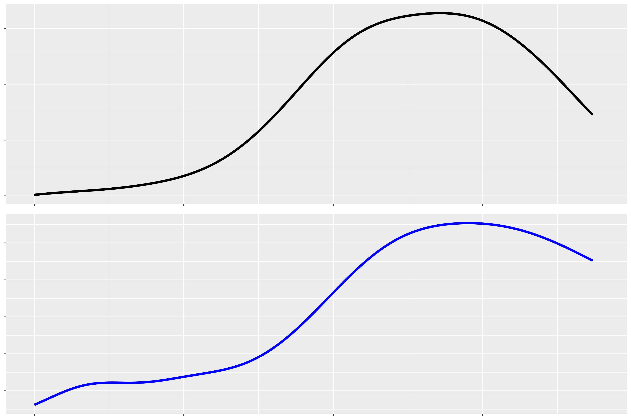
Real-time MRI
Velum opening
Tongue tip height
Bis er Bunte erklärt
['bʊnt^{s}ə]
Time
b ʊ n

Slide 14
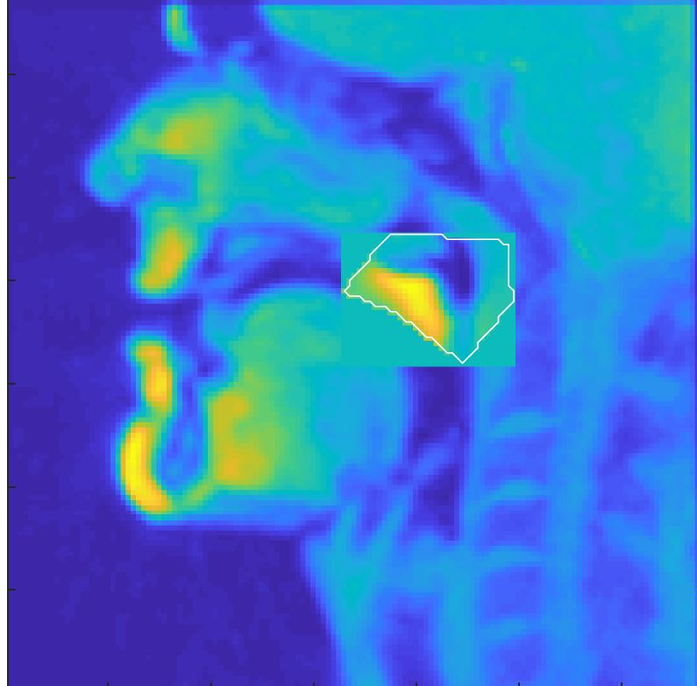
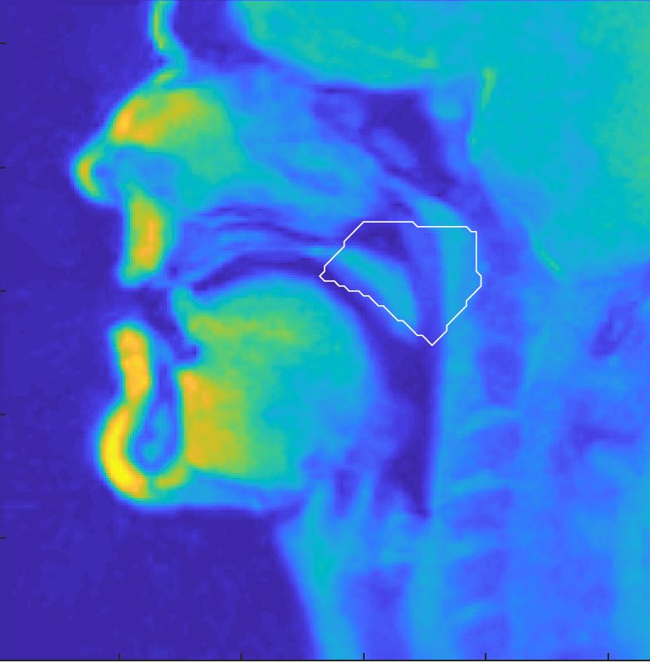
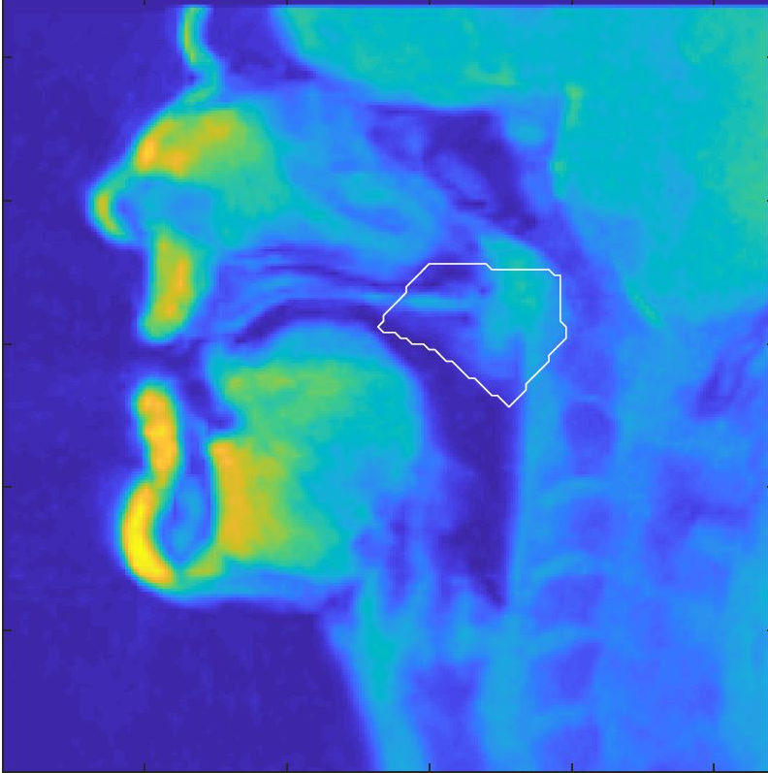
Processing velum opening
Application of Principal Components Analysis to a region of interest
PC weights in region of interest
High PC score
(lowered velum)
Low PC score
(raised velum)

Slide 15
Processing tongue tip height
Tongue tip height:
mean pixel intensity calculated per grid line then averaged over the first three lines

Slide 16
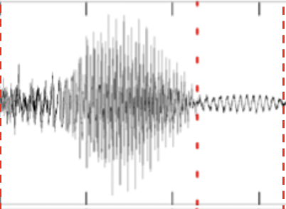
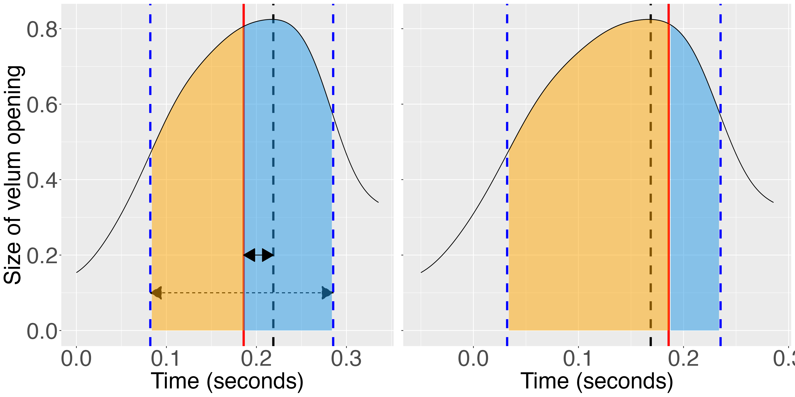
1. Alignment of peak velum opening
Predictions
o_{t}
VN_{t}
p_{t}
r_{t}
p_{t} − VN_{t}
r_{t} − o_{t}
>
V
N
N/(V+N)

Slide 17
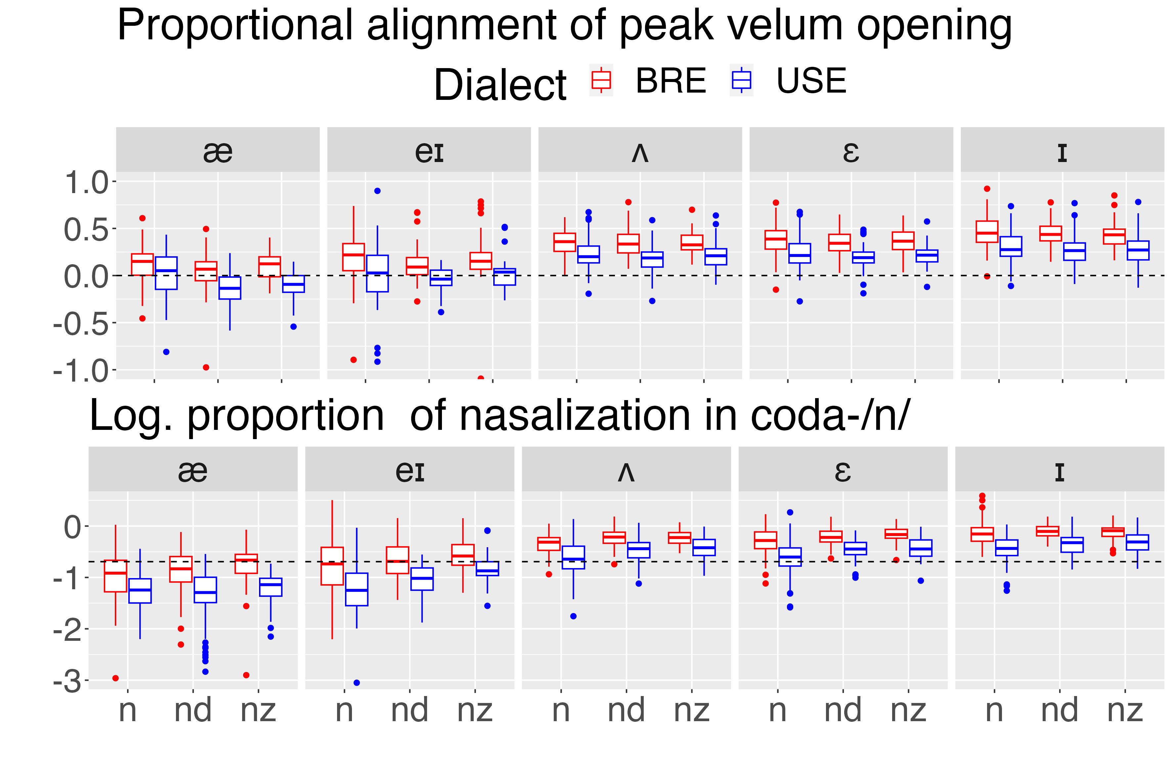
p_{t} − VN_{t}
>
N/(V+N)
>
Notes:
fig2

Slide 18
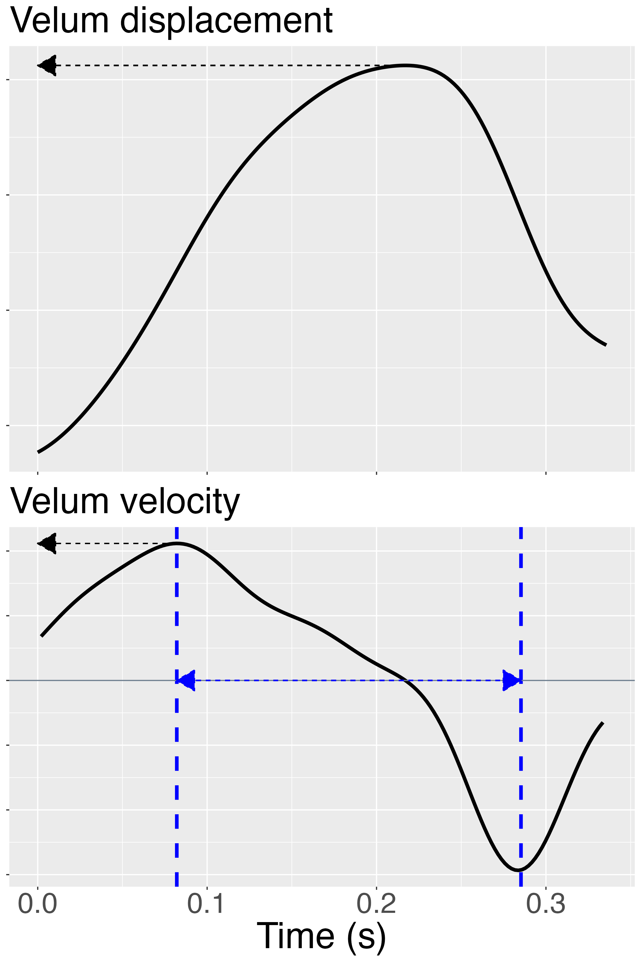
2. Stability of velum gesture
1.
1. Peak velum displacement.
2. Peak velum opening velocity.
3. Velum articulatory duration.
Prediction
2.
≈
3.
if the velum gesture is stable
Notes:
fig3

Slide 19
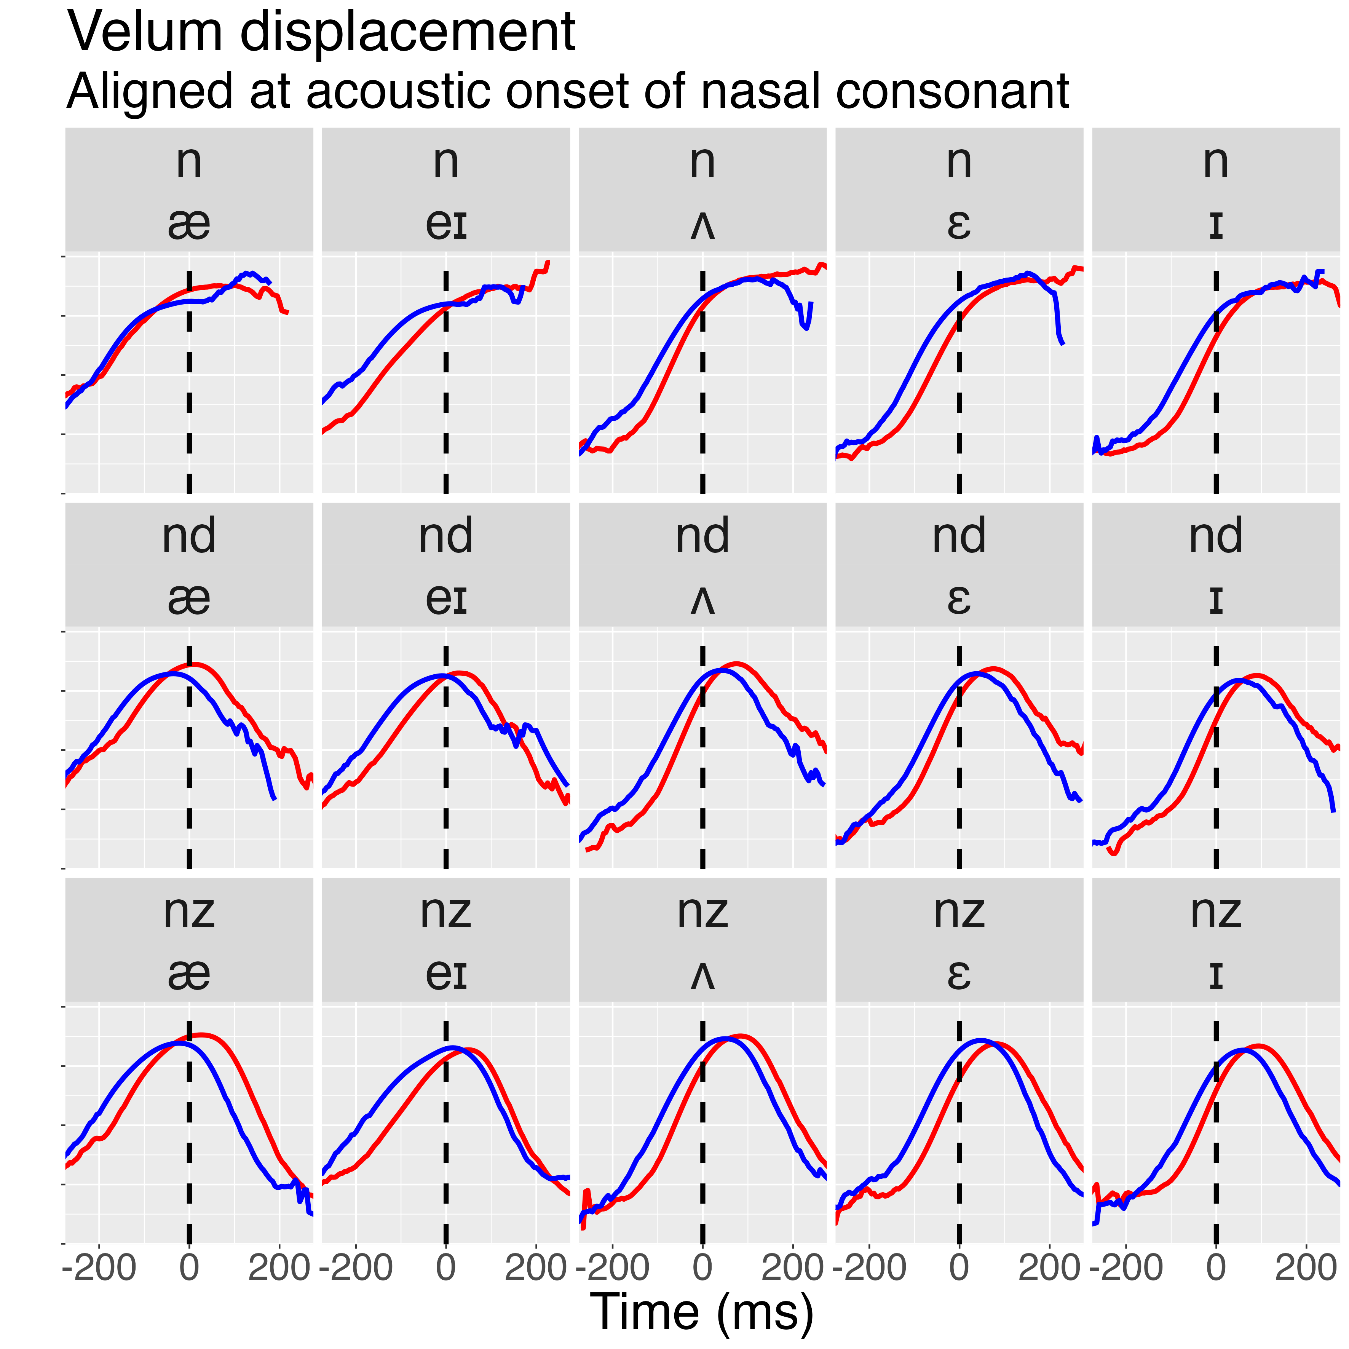
Stability of velum gesture
1. Peak velum displacement.
2. Peak velum opening velocity.
3. Velum articulatory duration.
For 1-3:
≈
Notes:
fig4

Slide 20
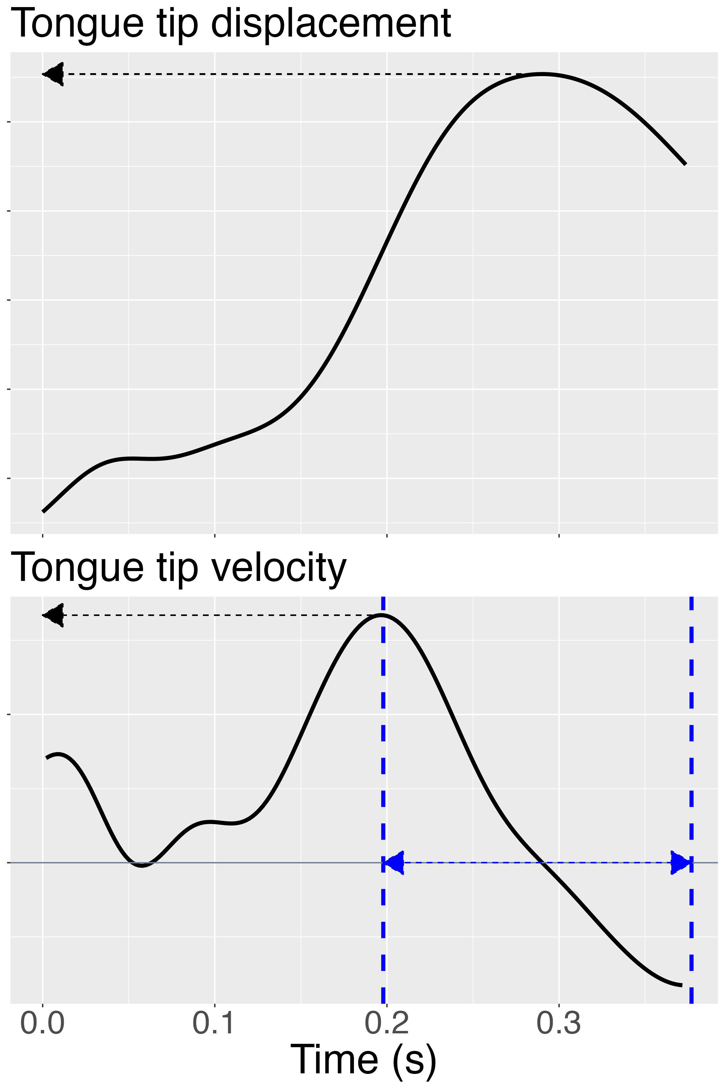
3. Reduction of tongue tip gesture
1.
1. Peak TT displacement.
2. Peak TT velocity.
3. TT articulatory duration.
Prediction for 1-3:
2.
>
3.
(TT data not analysed for /æ, eɪ/)
Notes:
fig.tti

Slide 21
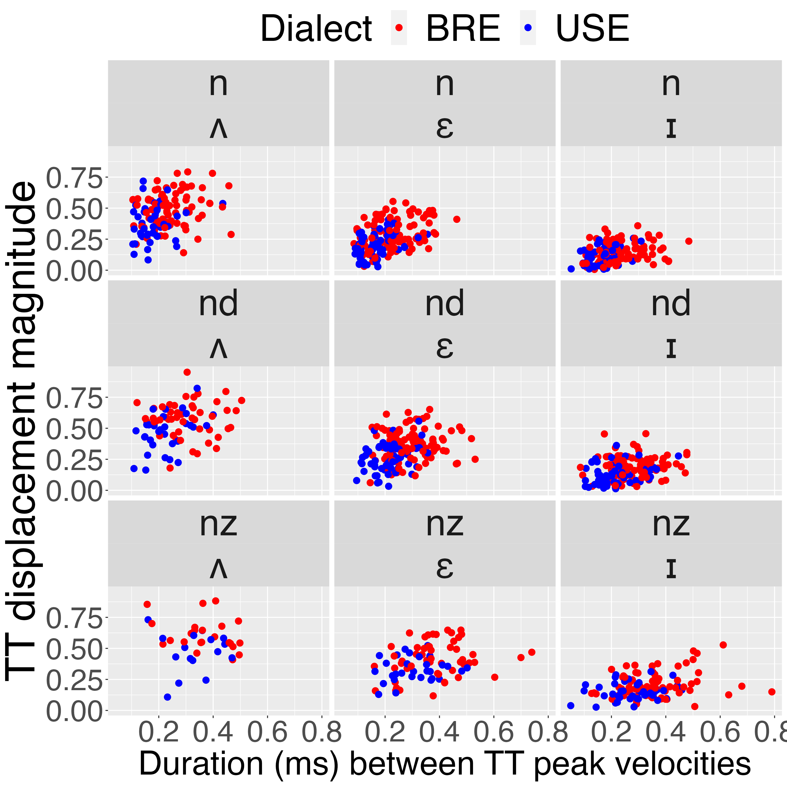
Size/length TT gesture in coda-/n/
1.
1. Peak TT displacement.
2. Peak TT velocity.
3. TT articulatory duration.
Results.
1, 3:
>
2:
≈
3.
Notes:
figtt_gesture

Slide 22
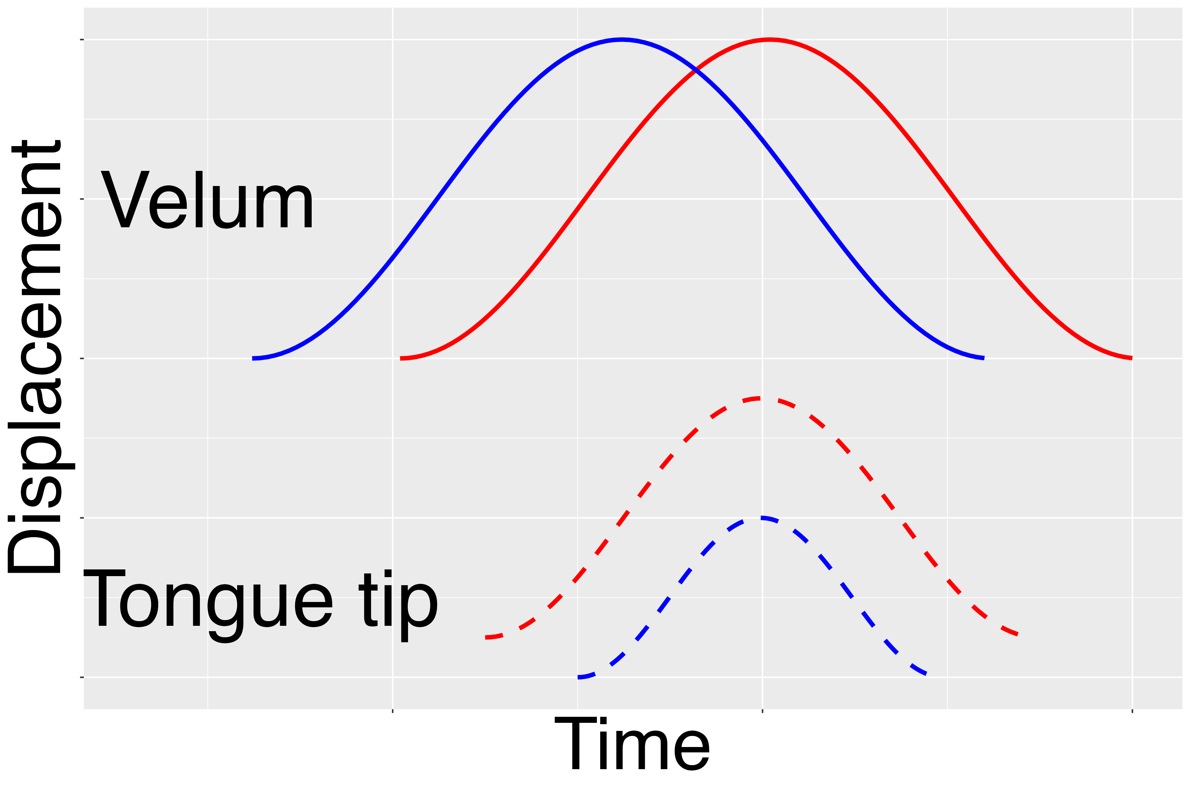
Summary so far
Test of cue-trading
late
cue-trading
velum alignment
early
more
less
Tongue tip lenition

Slide 23
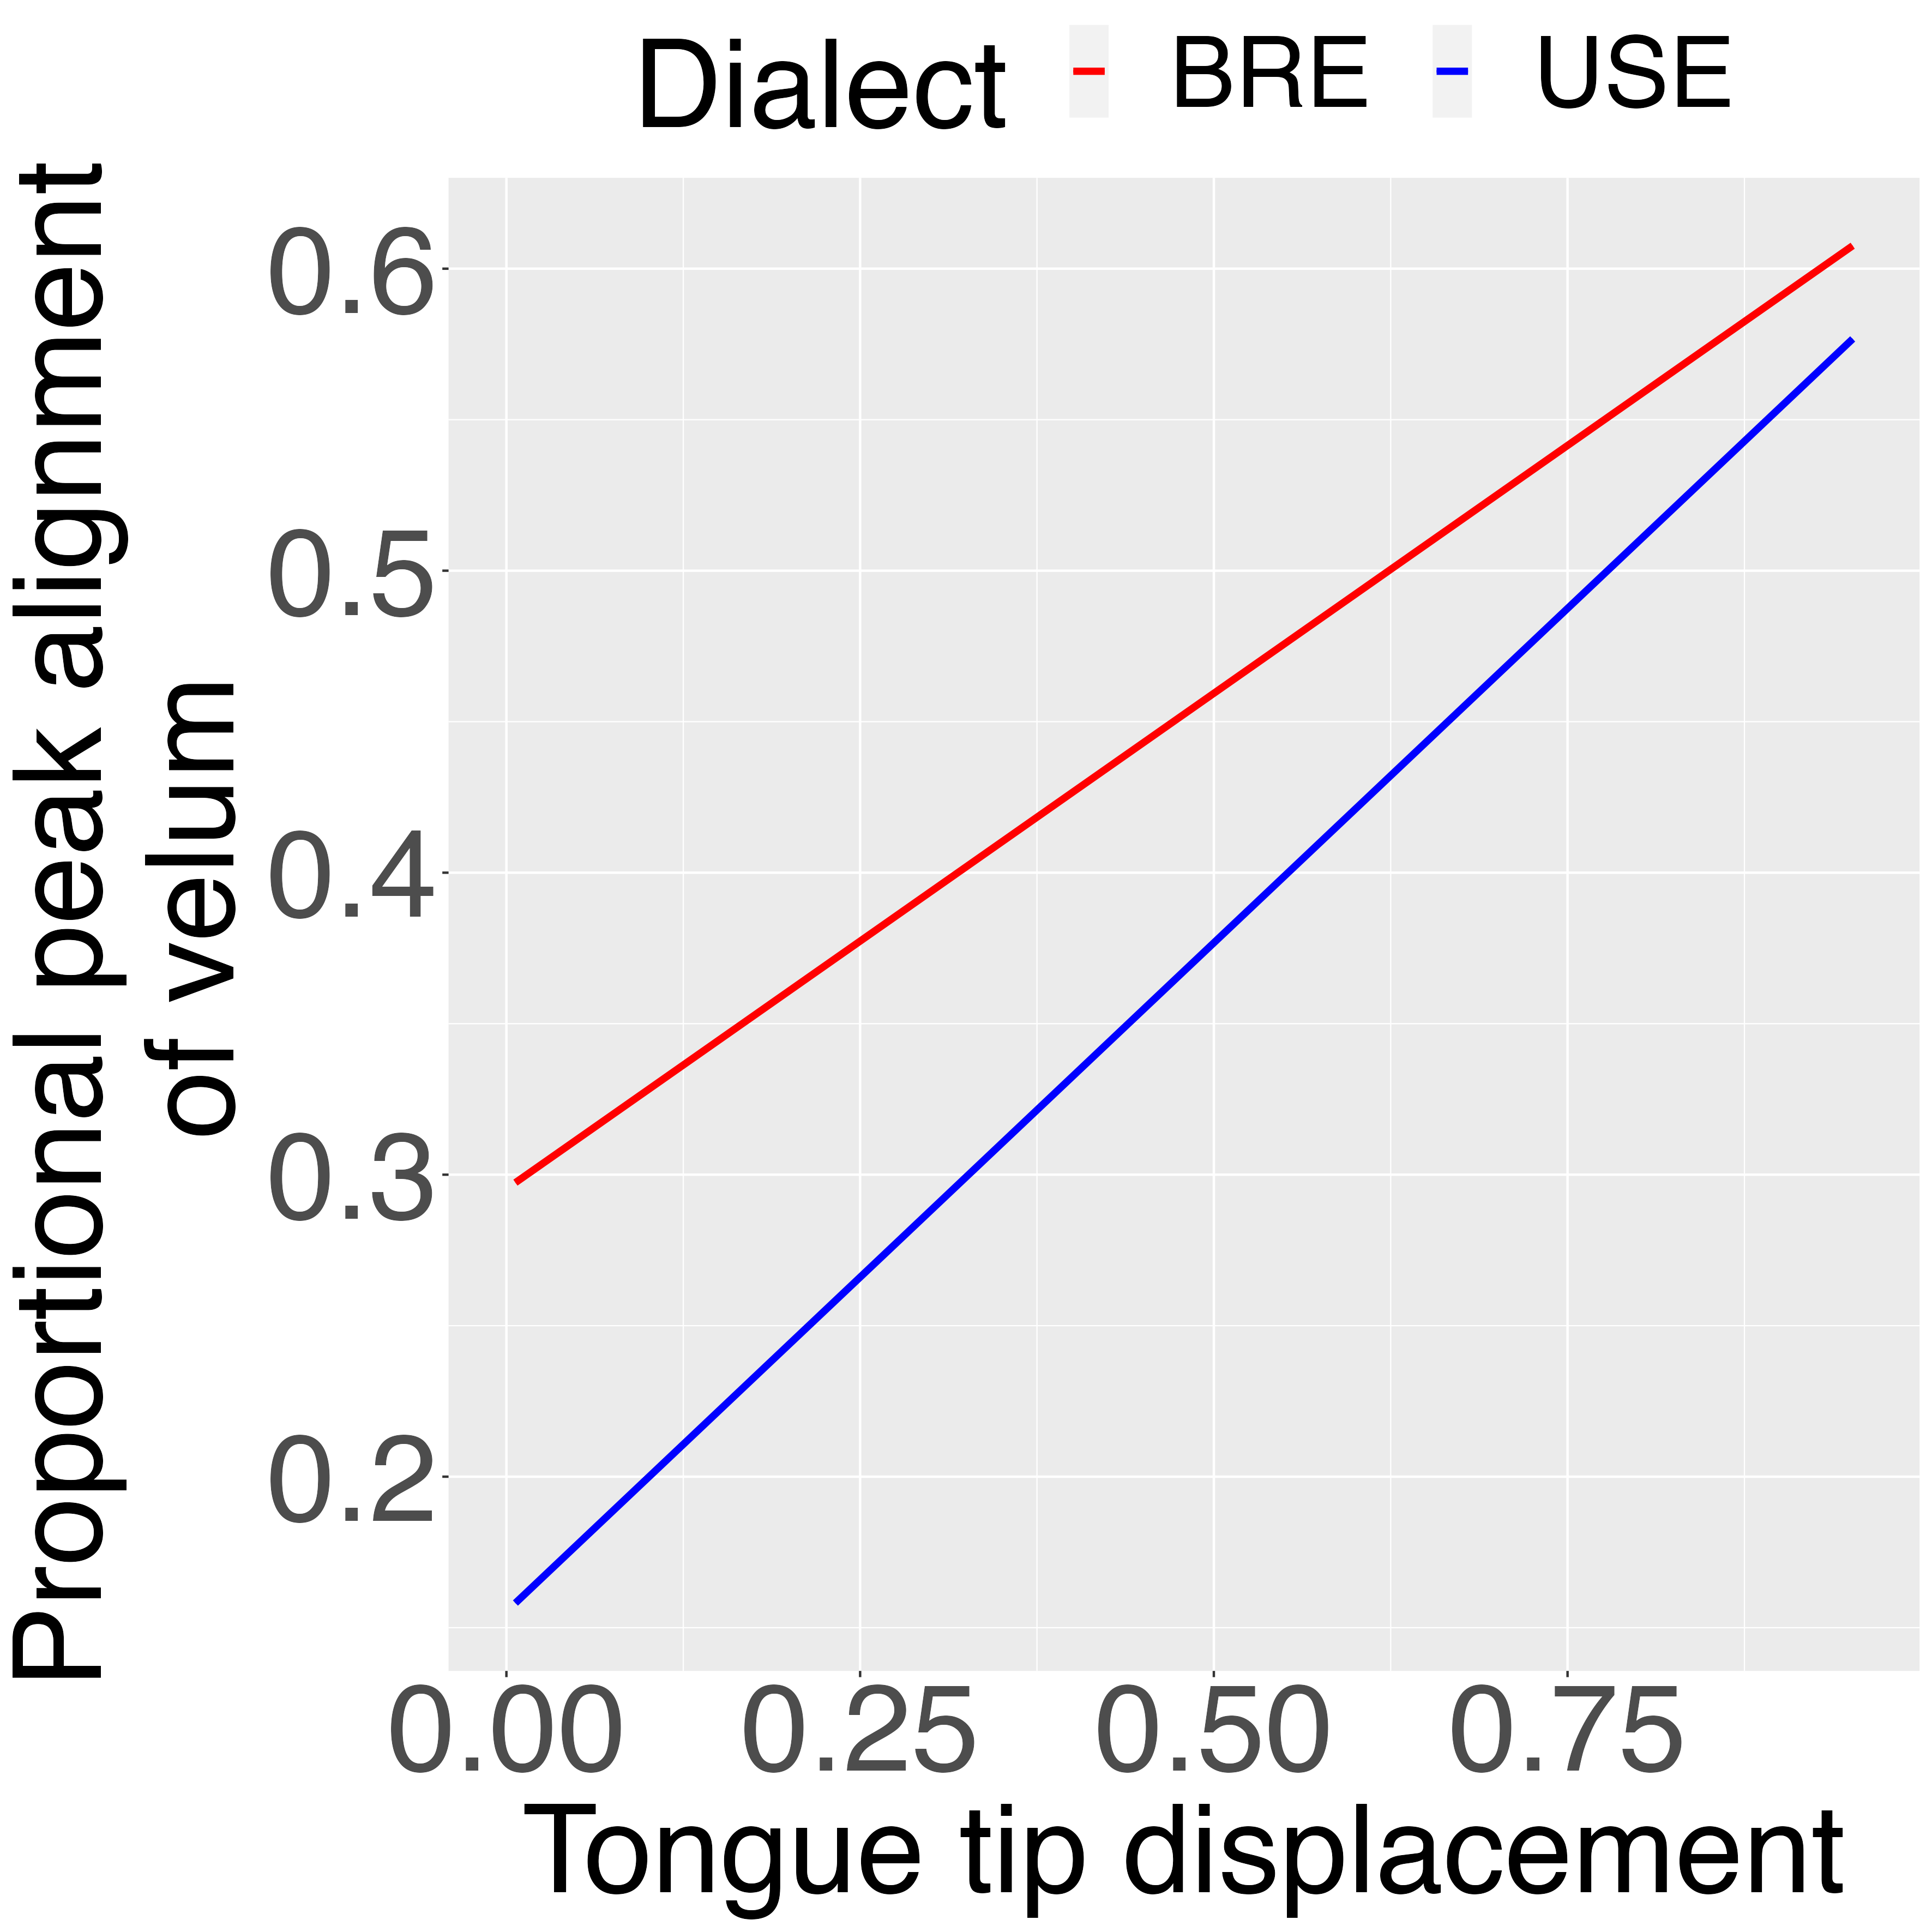
There is cue-trading
Within each dialect, an early alignment of the velum (= greater vowel nasalization) predicts tongue tip lenition.
Notes:
tradeall.png

Slide 24

Summary so far
But...
the model predicts an increasing asynchrony between the velum and tongue tip as the velum slides to the left, earlier in time (leaving the tongue tip 'stranded').
Is this asynchrony greater in
than in
?
+ cue-trading
no
No.

Slide 25
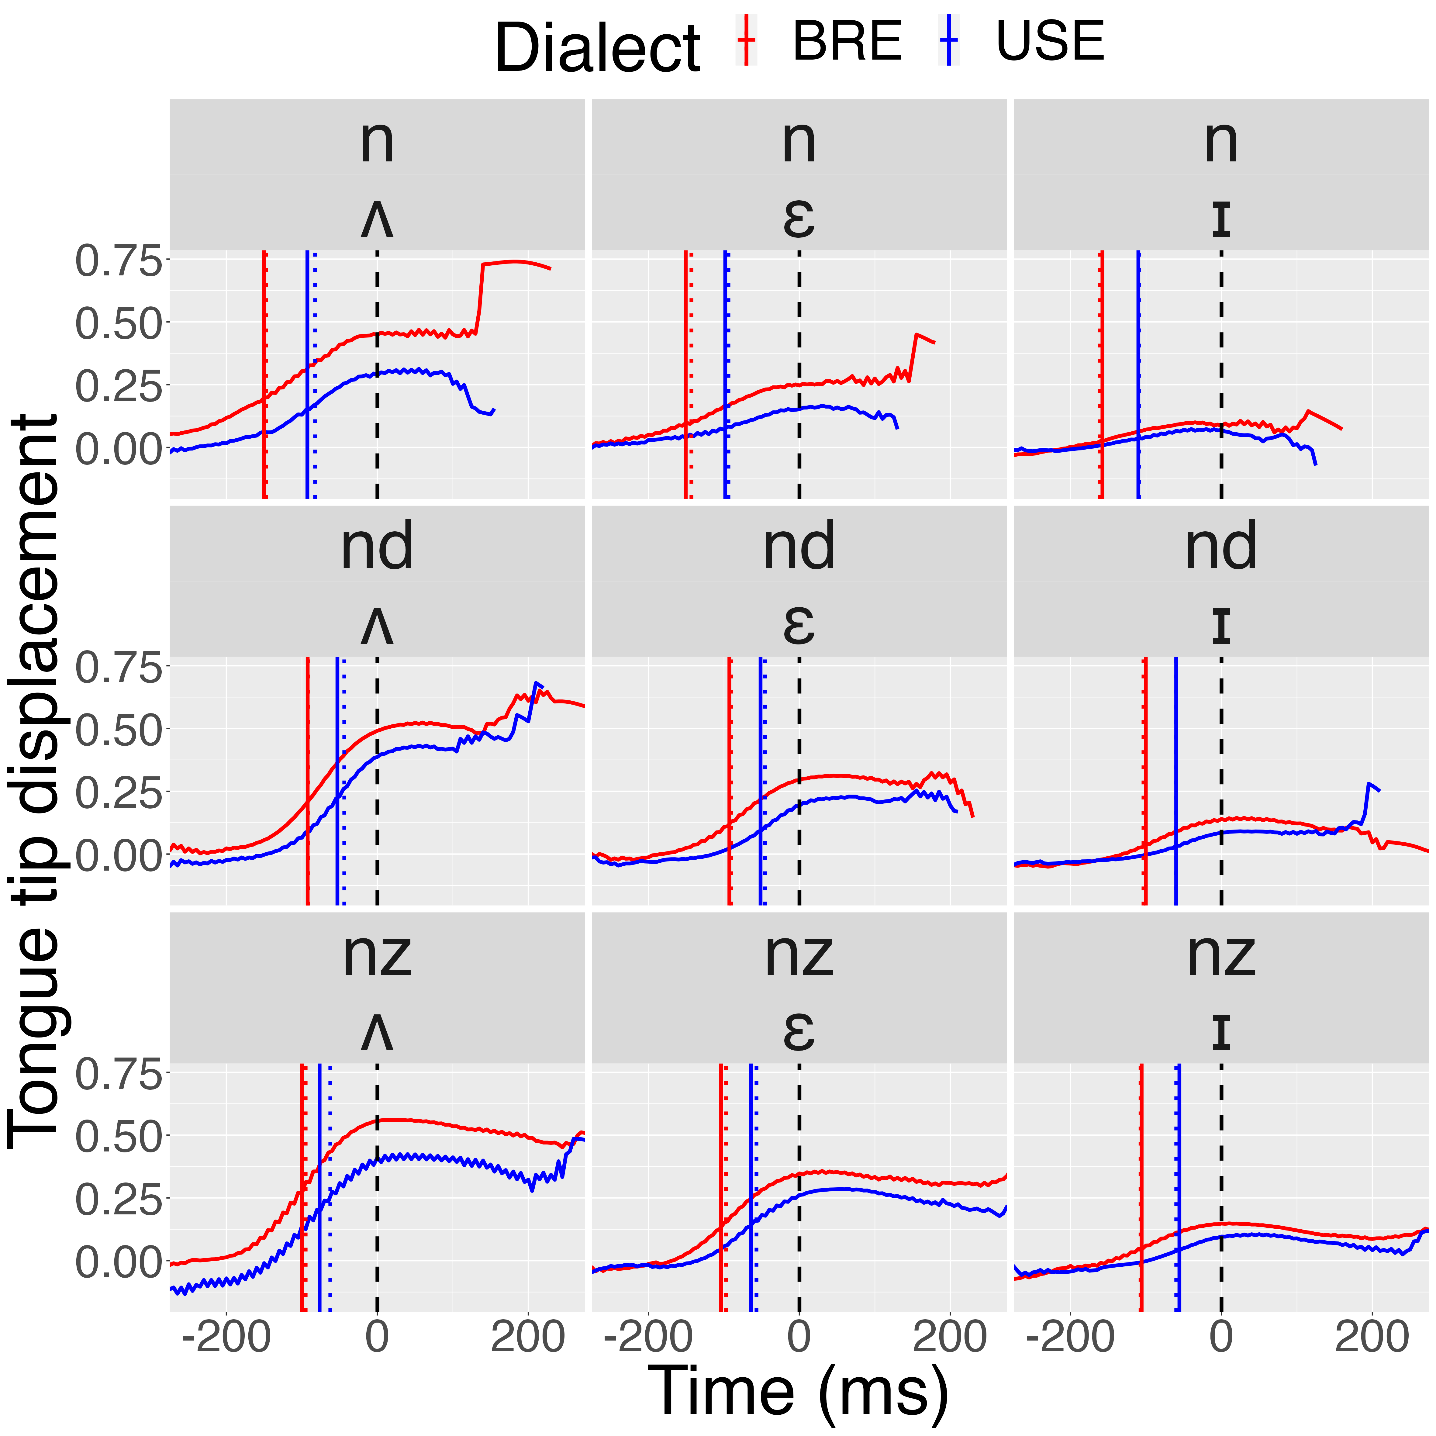
Tongue tip aligned at peak velum lowering (t = 0)
time of tongue tip
peak velocity
≈
time of acoustic boundary between V and N

Slide 26
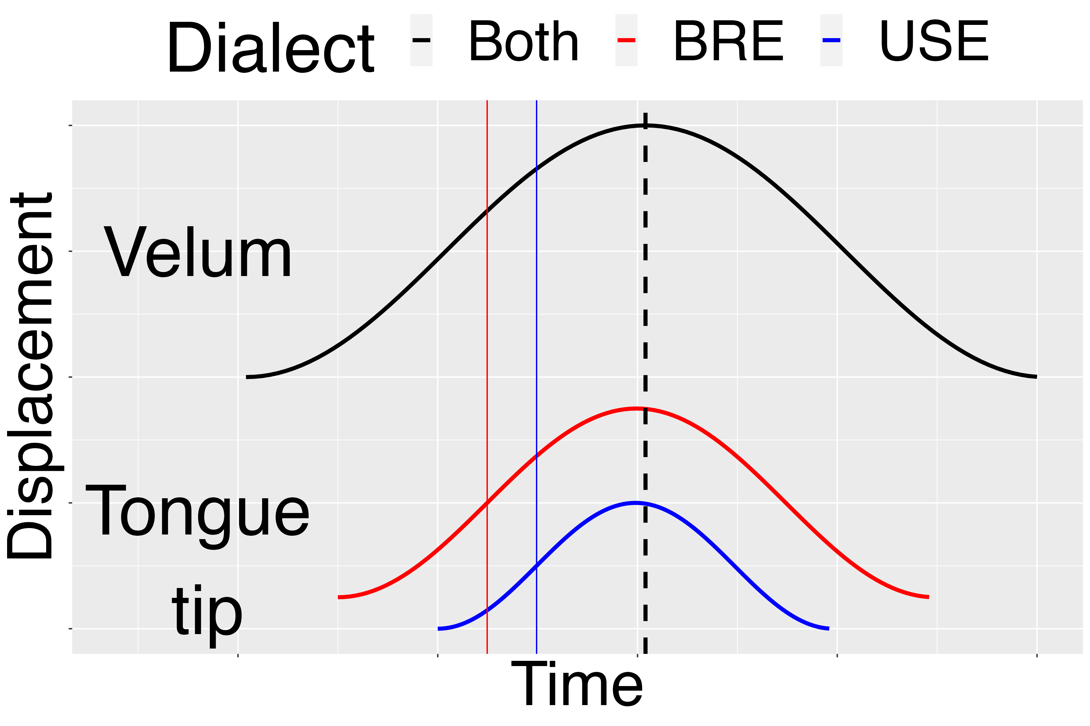
Schematic summary
In USE vs. BRE
The velum gesture doesn't move to the left: instead, the VN boundary moves to the right (as a consequence of tongue tip lenition).
Times of tongue tip peak velocity
≈
Acoustic boundary times between V and N

Slide 27
Conclusion
What drives Vn > Ṽn > Ṽ^{n} > Ṽ ?
1. Lenition of the oral gesture in N both 'vertically' (TT lenition) and 'horizontally' (encroachment of V on N)
2. Because of 1., the integrity (segmenthood) of N as [+coronal, +nasal] is dismantled (reduction/lenition targets [+coronal] but not [+nasal]).
3. Cue-reweighting is a gradual and inevitable consequence of TT reduction (the more TT reduces, the more the VN boundary shifts later in time).
4. In this proposed lenition model, the tongue-tip gesture in N is not stranded by a moving velum gesture (the velum gesture doesn't move).

