Slide 1
Pre-consonantal /s/-retraction
Mary Stevens, Véronique Bukmaier, Jonathan Harrington
18th International Conference of Phonetic Sciences
10-14 Aug 2015 SECC Glasgow Scotland UK

Slide 2
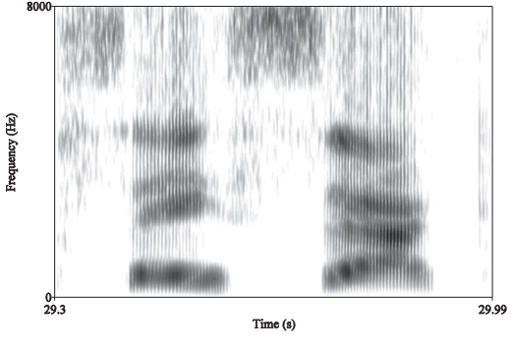
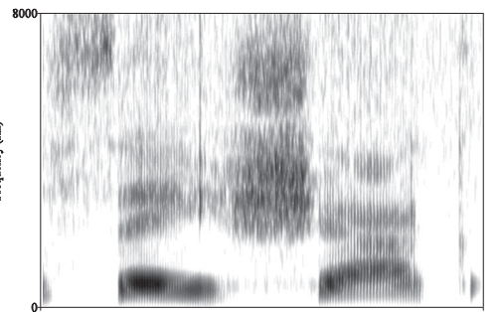
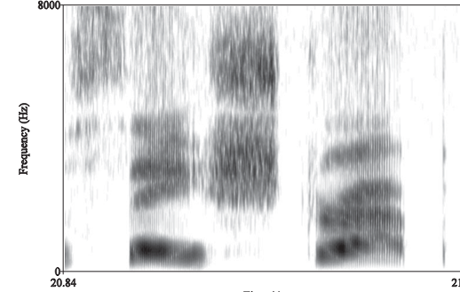
/s/-retraction before /r/
  e.g. American English /str/
  /str/ > [ʃtr] due to coarticulation with the rhotic
  from Rutter (2011:35)
sack
shack
strap

Slide 3
Retraction also happens in /sC/
/sC/ > /ʃC/
  Standard German (Weinhold, 1968)
  Standard Portuguese (Kümmel, 2007)
  Many regional varieties of Italian (Rohlfs 1966)
  Swabian German (Bukmaier et al., 2014)
  Why does /sC/ > /ʃC/ happen?
  Also due to coarticulation?

Slide 4
A proposal: /sC/ > /ʃC/ via coarticulation
  Before /sC/ > /ʃC/ takes place, sibilants in /sC/
  Should be more retracted in production
  If spliced out, should sound more /ʃ/-like
  Require normalization by listeners
  …to avoid confusion with /ʃ/ and eventual sound change (Beddor 2009, Harrington et al. to appear)
    Baker et al. 2011; Iskarous et al. 2011
Notes:
Our idea/Motivation
Acoustic evidence only for American English
Can we replicate this for other languagesß

Slide 5
1. Production
16 German speakers
Target words:
/vısə/, /lıstə/, /kıstə/
First spectral moment (M1) within 25-75%

Slide 6
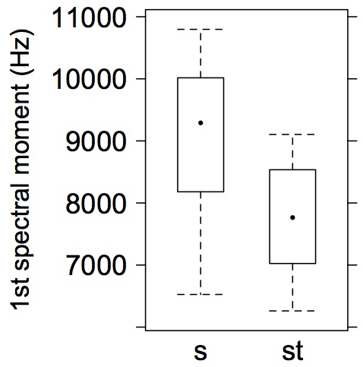
German speakers retract /s/ before /t/
***
1st spectral moment (Hz)
Fill boxes red and blue
sə st

Slide 7
  Sibilants in /sC/:
  Should be more retracted in production
  If spliced out, should sound more /ʃ/-like
  Require normalization by listeners
✔
Notes:
Our idea/Motivation
Acoustic evidence only for American English
Can we replicate this for other languagesß

Slide 8
2. Perception
Fill boxes red and blue
ʃə
ʃə
sə
sə
[s]ə
(n=16)
(n=16)
[s]t
Listeners’ task: “s” or “ʃ”
We predict more “ʃ” for this continuum
Notes:
Prevocalic s-S continuum
Preconsonantal s-S continuum
Inserted sibilants into V__V context
For all stimuli participants decided, whether they heard /s/ or /S/

Slide 9
sə
sə
…More “ʃ” responses for [s] spliced out of st
S ʃ
Notes:
Listeners hear the difference in fricative noise

Slide 10
  Sibilants in /sC/:
  Should be more retracted in production
  If spliced out, should sound more /ʃ/-like
  Require normalization by listeners
✔
✔
Notes:
Our idea/Motivation
Acoustic evidence only for American English
Can we replicate this for other languagesß

Slide 11
3. Perception
ʃə
ʃt
sə
st
[s]t
(n=16)
(n=16)
Fill boxes red and blue
Listeners’ task: “s” or “ʃ”
We expect more “s” for this continuum
Notes:
Prevocalic s-S continuum
Preconsonantal s-S continuum
Inserted sibilants into V__V context
For all stimuli participants decided, whether they heard /s/ or /S/

Slide 12
More “ʃ”, not more “s”!
st
sə
…Listeners do not normalize for retraction
S ʃ
Notes:
More s- responses in preconsonantal context? NO
Responses should be the same, because same acoustic information during the fricative.
But putting a fricative before a /t/ makes it sound like a /S/

Slide 13
  Sibilants in /sC/:
  Should be more retracted in production
  If spliced out, should sound more /ʃ/-like
  Require normalization by listeners
✔
✔
✗
Notes:
Our idea/Motivation
Acoustic evidence only for American English
Can we replicate this for other languagesß

Slide 14
Summary
Speakers retract /s/ before /t/
Consistent with American English /#st/
(2) Listeners perceive the difference in the fricative noise (more “ʃ”)
(3) Listeners do NOT normalize for the difference in the fricative noise (more “ʃ” before /t/)
No obvious explanation
but consistent with Mann & Repp, 1980
Insufficient normalization for context by listeners (Beddor 2009, Harrington et al., to appear) cannot account for /sC/ > /ʃC/

Slide 15
Conclusion
Sound change | Why? | How?
sCr > ʃCr | Retraction in production. Effect of rhotic on [s]
sC > ʃC | Retraction in production. Why? | ??
Listeners no longer normalize for contextual effects
Notes:
Evidence for retraction in /st/ in production and perception, but still unclear why retraction occurs in /sC/ sequences

Slide 16
Baker, A., Archangeli, D., & Mielke, J. (2011). Variability in American English s-retraction suggests a solution to the actuation problem. Language Variation and Change, 23, 347-374.
Beddor, P. (2009). A coarticulatory path to sound change. Language, 85, 785-821.
Bukmaier, V., Harrington, J., & Kleber, F. (2014). An analysis of post-vocalic /s-ʃ/ neutralization in Augsburg German: evidence for a gradient sound change. Frontiers in Psychology, 5, 1-12.
Harrington, J., Stevens, M. & Kleber, F.(to appear). The relationship between the (mis-)parsing of coarticulation in perception and sound change: evidence from dissimilation and language acquisition. In: A. Esposito and M Faundez-Zany (Eds.). Recent Advances in Nonlinear Speech Processing. Springer Verlag.
Iskarous, K., Shadle, C. H., & Proctor, M. I. (2011). Articulatory–acoustic kinematics: The production of American English /s/. J. Acoust. Soc. Am., 129(2), 944-954.
Kümmel, M. J. (2007). Konsonantenwandel: Bausteine zu einer Typologie des Lautwandels und ihre Konsequenzen. Wiesbaden: Reichert.
Mann V. and Repp B. (1980). Influence of vocalic context on the perception of [ʃ]-[s] distinction: I. Temporal factors. Perception and Psychophysics, 28, 213-228.
Rutter, B. (2011). Acoustic analysis of a sound change in progress: The consonant cluster /stɹ/ in English. J. International Phonetic Association, 41, 27-40.
Weinhold, K. (1968). Bairische Grammatik. Wiesbaden: Dr. Martin Sändig oHG
Research supported by ERC grant number 295573 ‘Sound change and the acquisition of speech’ to Jonathan Harrington

Slide 17
CONTINUA

Slide 18
the power spectrum for each target fricative by applying a 256-point discrete Fourier transform with a 40 Hz frequency resolution, 5 ms Blackman window and a frame shift of 5 ms. We then obtained the first spectral moment (M1) over 500-15000 Hz, and calculated the mean M1 within the temporal middle half (25-75%) of each fricative. Fig. 1 shows that M1 for /s/ was lower before /t/ than in intervocalic position. A mixed model with M1 as independent variable, context as fixed factor and speaker as random factor confirmed this pattern (X²[1]=16.8, p < 0.001).

Slide 19
Perception
Two continua:
vermi[s]e – vermi[ʃ]e
(/fəɐmısə/, 1. pers. sing. miss; /fəɐmıʃə/, 1. pers. sing. mix)
mi[s]t – mi[ʃ]t
(/mıst/, dung; /mıʃt/, 3. pers. sing. Mix)
Cut and spliced sibilants:
1. mi[s/ʃ]t
2. mi[s/ʃ]t
3. vermi[s/ʃ]e
4. vermi[s/ʃ]e
16 German listeners; 2AFC experiment with 10 repetitions per stimulus
Notes:
For our perception experiment we created two synthetic continua between German real words: one prevocalic continuum in which we morphed vermisse & vermische sound files and one preconsonantal continuum in which we morphed mist-mischt sound files.
Afterwards we cut the sibilant sequences out of each continuum and cross-spliced them into the two contexts. That is, preconsonantal /s-S/ was spliced into the prevocalic context and vice versa. At the end we received four continua: Continuum number one and four represent the continua, where the sibilants fitted the surrounding contexts. And continuum number two and three show the cross-spliced conditions.
16 Standard German listeners participated in our 2 alternative forced choice experiment with 10 repetitions per stimulus

