Slide 1
Sound change actuation /s/-retraction in Australian English
Mary Stevens
Jonathan Harrington
VIU September 23, 2014

Slide 2
Sound change actuation
If sound change is accumulated coarticulation and misperception
“…Why [sound change] in a particular language at a given time, but not in other languages with the same feature, or in the same language at other times?”
Weinreich, Labov & Herzog (1968)

Slide 3
“…a theory in which sound change can plausibly occur, but without making sound change inevitable”
Baker, A., Archangeli, D. & Mielke, J. (2011:350). Variability in American English s-retraction suggests a solution to the actuation problem. LVC 23: 347-374.
Speaker-specific differences in coarticulation help explain actuation
/s/-retraction

Slide 4
/s/-retraction
/stɹ/ > [ʃtɹ] stream, stripe
Philadelphia English (Labov 1984) , Southwest Louisiana (Rutter 2011), Columbus (Durian 2007); New Zealand (Warren 2006)…

Slide 5
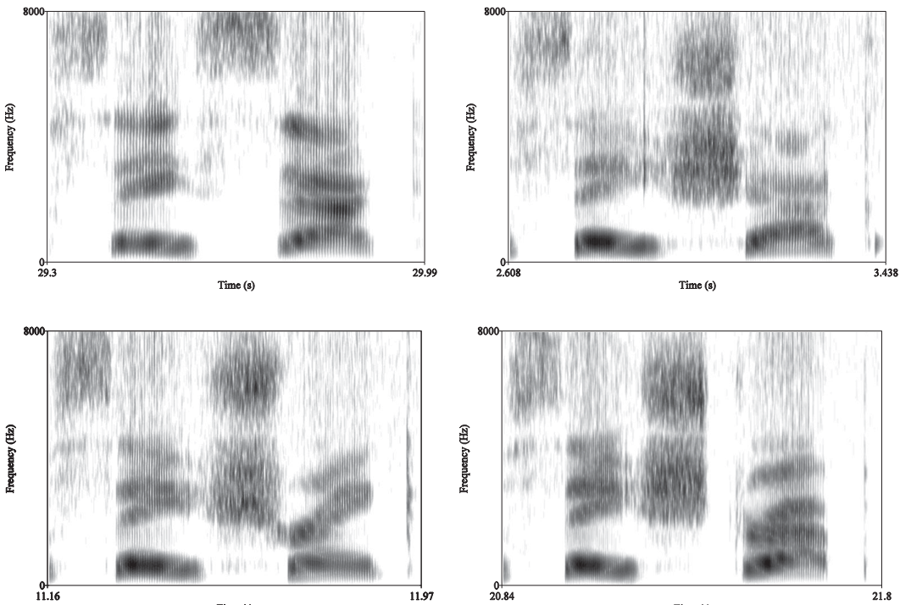
Say sack
Say shack
Say shrank
Say strap
(Rutter 2011:35)

Slide 6
/s/-retraction
Coarticulatory anticipation of /r/ in /str/(e.g. Baker et al. 2011)
Word-initial /str/ first affected (Rutter 2011)
Spreading to other contexts in American English (Janda & Joseph 2003)
screen, sprinkler
disrespect
still, school, small

Slide 7
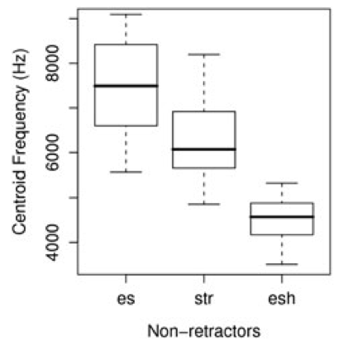
Baker et al. (2011)
Coarticulatory bias towards [ʃ]
Even speakers judged to produce [str] have lower CoG in street than seat

Slide 8
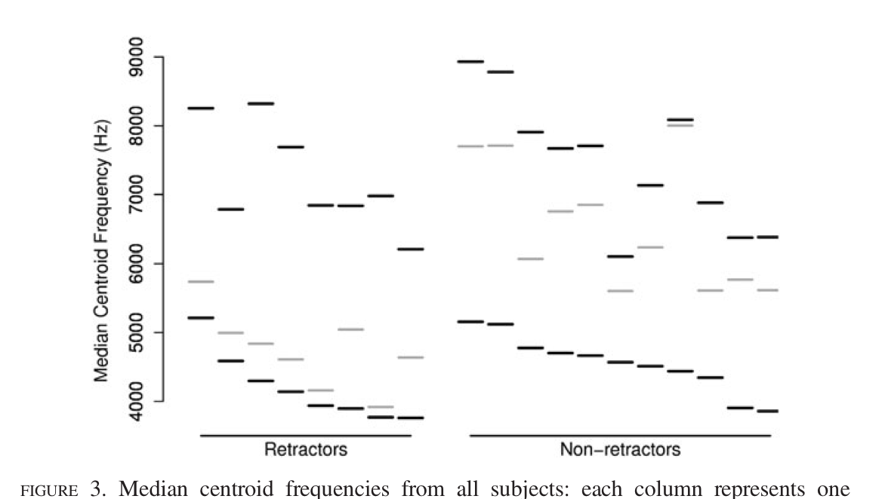
Individuals differ as to the extent of this bias
[ʃtɹ] more likely to be phonologized (than other coarticulation patterns) because it is speaker-specific. Why?
(b)
(a)
/s/
/str/
/ʃ/

Slide 9
Sound change actuation…
Speaker (a): /str/ with extreme phonetically-motivated coarticulation
Listener (b): interprets as [ʃtɹ] (& may adopt this pronunciation)
(b)
(a)
Notes:
variation beyond phonetic motivation

Slide 10
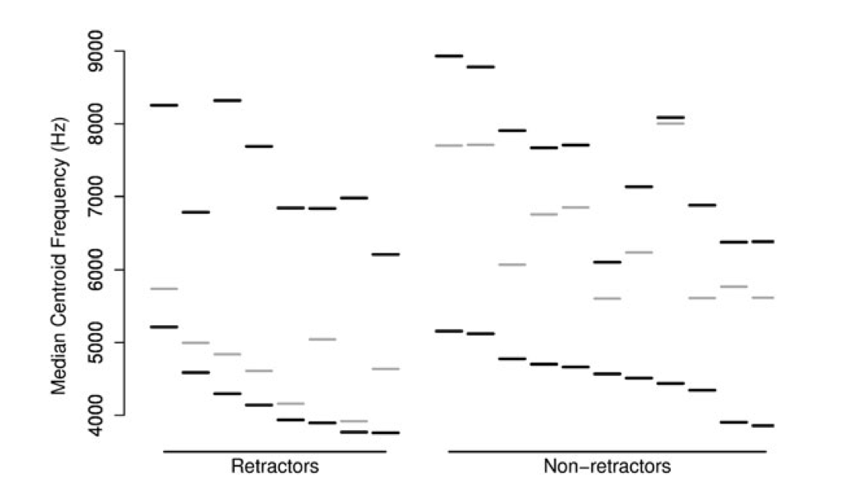
Notes:
variation beyond phonetic motivation

Slide 11
Notes:
variation beyond phonetic motivation

Slide 12
Baker et al. (2011)
Sound change is
Plausible
Coarticulatory bias towards [ʃtɹ] in their production data
Not inevitable
Initiation depends on chance interactions between individuals with extremely different productions
Phonetic extremes documented in their production data
Notes:
variation beyond phonetic motivation

Slide 13
What about listener-specific perceptual sensitivity (e.g. Beddor 2009) and cognitive processing style?
And are extremely different phonetic pronunciations really more likely to drive to sound change?
Notes:
variation beyond phonetic motivation
More convergence found for acoustically different dialect vowel pairs (e.g. DRESS v. THOUGHT, Babel 2010)

Slide 14
Slight phonetic differences…
would not be detected; such tokens would be included amongst stored exemplars (Garrett & Johnson 2013)
Imitation studies show more convergence
For speaker pairs with same dialect background (Kim et al. 2011)
Within native production range (Olmstead et al. 2013)
Notes:
variation beyond phonetic motivation

Slide 15
Testing Baker et al.‘s (2011) model
Expose a group of speakers from a variety without /s/-retraction to extreme [ʃtɹ] pronunciations

Slide 16
Predictions
Extreme “non-retractors” should show a change in the direction of extreme [ʃtɹ]
Those with [ʃ] or [s-ʃ] should not shift (either not detecting any difference or perceptually compensating for it)
(b) Should shift down
(a) Should not shift

Slide 17
/s/-retraction not typically reported for Australian English (e.g. Cox & Palethorpe 2007)
“a readily available example of [∫tr] can be heard in the pronunciation of strong as [∫]trong by a young Australian actor playing the role of the boy Lucius in the recent (2000) film Gladiator” Janda & Joseph (2003:19)
Notes:
http://www.visitnsw.com/destinations/country-nsw/queanbeyan-area/braidwood/gallery

Slide 18
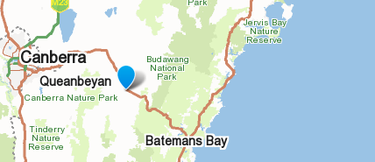
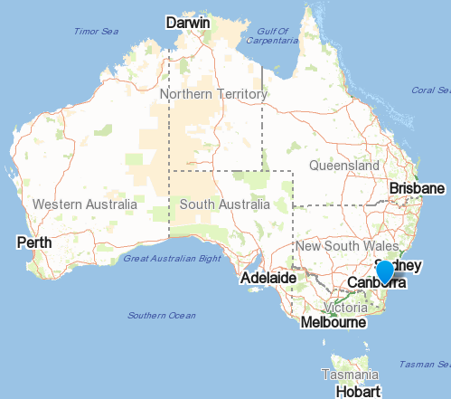
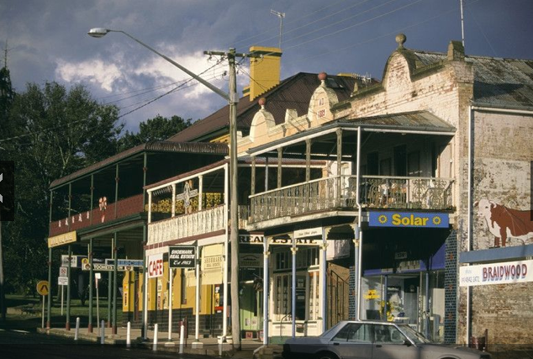
Australian English: two corpora
Australian National Corpus of Spoken Language (ANDOSL)
Recordings underway in Braidwood, NSW (pop. 1000)
Notes:
http://www.visitnsw.com/destinations/country-nsw/queanbeyan-area/braidwood/gallery

Slide 19
ANDOSL
34 read phrases (108 male & female speakers)
Recorded ~ 1996
Segmented with WebMaus for AusE
Post-vocalic word-initial /s, sCr, ʃ/ (not enough medial sCr)
/s/ (n =538) salmon, say, sent, sore, see
/ʃ/ (n=645) shop, shall, sheer, shared, sharp
/str, skr/ (n=431) street, strawberries, strong, scratch
Spectrum calculated between onset-offset of /s, ʃ/ at 5ms intervals over 500 -10 000 Hz.
Scaled to Mel, first spectral moment calculated
Notes:
http://www.visitnsw.com/destinations/country-nsw/queanbeyan-area/braidwood/gallery

Slide 20
ANDOSL: mean M1
/str/ lower than /s/ first 60 %
No retraction in /skr/

Slide 21
ANDOSL: Mean M1 over first 50%
MM: significant effect of Onset (/s/, /skr/, /str/, /ʃ/) on mean M1 over 0-50%
Only /s/ vs. /ʃ/ pair is significantly different (Tukey)

Slide 22

ANDOSL
M1 tracked over 0-50% is visibly lower for /#str/
Phonetic bias even for “non-retractors”
/#str/ not sig. diff. from /s/; remains distinct from /#ʃ/
AusE lacks /s/-retraction
Speaker-specific coarticulation in /str/?

Slide 23
Australian National Corpus of Spoken Language (ANDOSL)
Recordings underway in Braidwood, NSW
pop. 1000
Notes:
http://www.visitnsw.com/destinations/country-nsw/queanbeyan-area/braidwood/gallery

Slide 24
Braidwood experiments
Production study
Speaker specific coarticulation for /#str/?
Shadowing
Only “non-retractors” should change towards (model talker’s) extreme [ʃtɹ] pronunciations
Perception task
Sensitivity to [s] vs. [ʃ] (vs. imitation)

Slide 25
Production study
(so far) 9 female monolinguals aged 30-45
10 targets + 12 fillers * 10 repetitions = 220 items
/#s/ seem, sane
/#ʃ/ sheep, Shane
/#sCr/ stream, sprain, scream
/sCr/ Australia
/#sC/ steam, Spain, scheme
/#tr/ tree, train
Carrier phrase “Any___”

Slide 26
Production study
(so far) 9 female monolinguals aged 30-45
10 targets + 12 fillers * 10 repetitions = 220 items
/#s/ seem, sane
/#ʃ/ sheep, Shane
/#sCr/ stream, sprain, scream
/sCr/ Australia
/#sC/ steam, Spain, scheme
/#tr/ tree, train
Carrier phrase “Any___”

Slide 27
Production study
(so far) 9 female monolinguals aged 30-45
10 targets + 12 fillers * 10 repetitions = 220 items
/#s/ seem, sane
/#ʃ/ sheep, Shane
/#sCr/ stream, sprain, scream
/sCr/ Australia
/#sC/ steam, Spain, scheme
/#tr/ tree, train
Carrier phrase “Any___”

Slide 28
BRAIDWOOD: mean M1
/s/
/str/
/ʃ/

Slide 29
(108 speakers)
/str/ ANDOSL
(9 speakers)
/str/ BRAIDWOOD

Slide 30
BRAIDWOOD
0.0 0.1 0.2 0.3 0.4 0.5
/ʃ/ sig. lower than all others
/skr/ vs. /str/ weakly sig. (p = 0.0153)
/s/ vs. /str/ and all others n.s.
Notes:
http://www.visitnsw.com/destinations/country-nsw/queanbeyan-area/braidwood/gallery

Slide 31
Speaker specific coarticulation in /#str/?
0.0 0.1 0.2 0.3 0.4 0.5
0.0 0.1 0.2 0.3 0.4 0.5
0.0 0.1 0.2 0.3 0.4 0.5
0.0 0.1 0.2 0.3 0.4 0.5
0.0 0.1 0.2 0.3 0.4 0.5

Slide 32
Classifying retractors vs. non-retractors
Native listener judgement (Baker et al. 2011)
Spectral peak (Rutter 2011)
/str/ for 11 speakers => s / ʃ / Intermediate
According to that speaker‘s /s/, /ʃ/ range

Slide 33
Classifying retractors vs. non-retractors
Overlap between /str/ and /ʃ/
= retraction

Slide 34
Classifying retractors vs. non-retractors
ʃ
str
s
/str/ lower than /s/
= retraction

Slide 35
Classifying retractors vs. non-retractors
ʃ
str
s
At 13 points along each speaker‘s mean trajectory (0-60%)calculated:
Euclidean distance /str/-/s/
Euclidean distance /str/-/ʃ/

Slide 36
Distance /str/-/s/
Distance /str/-/ʃ/
(1) No “retractors”

Slide 37
(2) /str/ intermediate
/str/ shouldn‘t change

Slide 38
(3) Little coarticulation in /str/ =>
/str/ should change

Slide 39
Word-medial /str/: Australia
Sane
Australia
Shane
/str/ < /s/; p <0.001

Slide 40
Summary: /s/-retraction
AusE not a retracting variety
But evidence of phonetic bias
For some speakers
Clearer in ANDOSL
Stronger in word-medial (contra Rutter 2011)
No retraction in /skr/, /spr/
Supports origin of the sound change in /str/ e.g. Janda & Joseph (2003)

Slide 41
Summary: sound change actuation
Only 9 speakers for Braidwood
But it appears to be a suitable testing ground...

Slide 42
Braidwood: next steps
Production study (with non-retracting variety)
Speaker specific coarticulation for /#str/?
Shadowing
Only “non-retractors” should change towards (model talker’s) extreme [ʃtɹ] pronunciations
Perception task
Sensitivity to [s] vs. [ʃ]

Slide 43
Babel, M. (2010). Dialect divergence and convergence in New Zealand English. Language in Society, 39, 437-456.
Baker, A., Archangeli, D., & Mielke, J. (2011). Variability in American English s-retraction suggests a solution to the actuation problem. Language Variation and Change, 23, 347-374.
Beddor, P. S. (2009). A coarticulatory path to sound change. Language, 85(4), 407-428.
Cox, F., & Palethorpe, S. (2007). Australian English. Journal of the International Phonetic Association, 37(3), 341-350.
Garrett, A., & Johnson, K. (2013). Phonetic bias in sound change. In A. Yu (Ed.), Origins of sound change: Approaches to phonologization (pp. 51-97): Oxford University Press.
Janda, R. D., & Joseph, B. D. (2003). Reconsidering the Canons of Sound-Change: Towards a “Big Bang” Theory. In Historical Linguistics 2001. Selected Papers from the 15th International Conference on Historical Linguistics (pp. 205-219). Amsterdam: John Benjamins.
Kim, M., Horton, W. S., & Bradlow, A. R. (2011). Phonetic convergence in spontaneous conversations as a function of interlocutor language distance. Laboratory Phonology, 2(1), 125-156.
Olmstead, A. J., Viswanathan, N., Aivar, M. P., & Manuel, S. (2013). Comparison of native and non-native phone imitation by English and Spanish speakers. Frontiers in Psychology, 4, 1-7.
Rutter, B. (2011). Acoustic analysis of a sound change in progress: The consonant cluster /stɹ/ in English. Journal of the International Phonetic Association, 41, 27 - 40.
Solé, M. J. (2010). Effects of syllable position on sound change: an aerodynamic study of final fricative weakening. Journal of Phonetics, 38, 289-305.
Warren, P. (1996). /s/-retraction, /t/-deletion and regional variation in New Zealand English /str/ and /stj/ clusters. Paper presented at the 11th Australian International Conference on Speech Science & Technology.
Weinreich, U., Labov, W., & Herzog, M. (1968). Empirical foundations for a theory of language change. In W. Lehmann & Y. Malkiel (Eds.), Directions for historical linguistics (pp. 95-198). Austin: University of Texas Press.

Slide 44
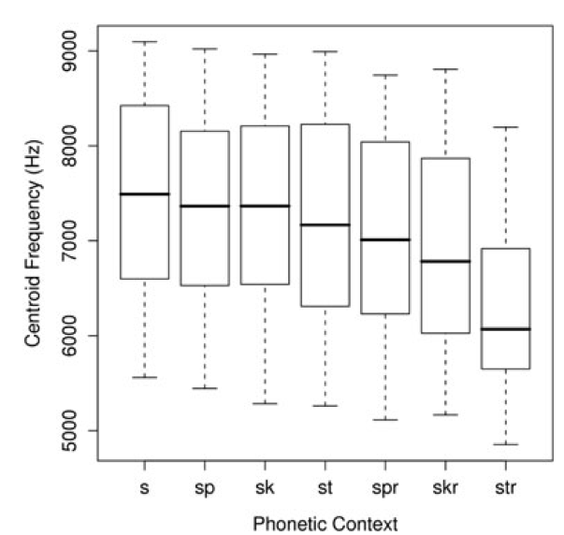
Averaged over 25-75% time points

Slide 45
Braidwood /100% track/

Slide 46
Slight phonetic differences and imitation
Perceptual salience vs. acoustic differences; awareness hinders accommodation (Babel 2010)
In spontaneous conversations, more convergence between speaker pairs who share the same dialect (Kim et al. 2011)
Spanish and English listeners shadowed [ba]–[pa] continuum. Less convergence outside native pronunciation range (Olmstead et al. 2013)
Notes:
variation beyond phonetic motivation

