Slide 1
LARYNGEAL CONTRAST AND SOUND CHANGE: THE PRODUCTION AND PERCEPTION OF PLOSIVE VOICING AND CO-INTRINSIC PITCH
Jiayin Gao & James Kirby (2024)
P1.1 Experimental Phonetik
Zhijun Ying
12/11/2024

Slide 2
Question for Discussion
Can Beddor‘s cue trading model for nasalization be applied to explaining tonogenesis?

Slide 3
Background
Co-intrinsic Pitch Perturbations and Sound Change
Vowel F0 is raised, relative to the presumed intonational baseline, following phonologically voiceless obstruents (Kirby & Ladd 2016), but lowered F0 following phonologically voiced obstruents has also been observed (Coetzee et al. 2018).
2 Leading Models
1) Ohala’s Model (1989)
Coarticulation rarely leads to sound change, because adult listeners are sensitive to induced variation and compensate for it in speech perception.
Sound change is fundamentally abrupt, the result of a perceptual parsing error on the part of the listener.
2) Beddors’ model (2009, 2023) – Coarticulatory Path Model (CoPath)
The source of change is parsing variability. The flexibility observed in cue may lead to individual differences in cue weights (Yu 2021).
Listeners may treat covarying cues to a phonological contrast as PERCEPTUALLY EQUIVALENT.

Slide 4
Background
Articulatory Covariation & Perceptual Equivalence
A robust trading relation— perceptual equivalence and articulatory covariation between coarticulatory source and effect-an inverse correlation between source and effect (i.e. when the source is weaker the effect is stronger, and vice versa).
The case of Vowel Nasalization
/VN/ in American English (e.g. in bent vs. bend)

Slide 5
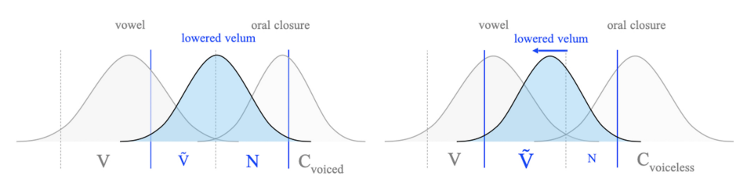
Background
Figure 1. Oral –nasal gestural alignment in two consonantal contexts (Gao & Kirby,2024)
Vowel nasality is longer and consonantal nasality is shorter in VNCvoiceless than in VNC voiced, and the (acoustic) durations of vowel nasality and consonantal nasality correlate negatively.
On the perception side, listeners are sensitive to the total duration of nasality, but not to whether nasality is present in the consonant or the preceding vowel. (Listeners do not perceptually differentiate source from effect.)

Slide 6
Motivation
Through a study of 2 cues to the laryngeal (voicing) contrast: closure voicing & pitch
To assess whether, and to what extent, articulatory-acoustic covariation and/or perceptual equivalence obtain between voicing and CF0 in Metropolitan French, a true-voicing language
whether voicing covaries with the magnitude of CF0 in production, both within and across categories
whether closure voicing and CF0 are treated as perceptually equivalent both within the voiced category and at the voiced-voiceless category boundary (i.e. whether they trade across a wide range of stimulus conditions, not just in configurations where the primary cue is ambiguous.)

Slide 7
Research Question
Production:
RQ1: Does VOT covary with onset F0 within the voiced and/or voiceless category?
RQ2: Does VOT covary with onset F0 across the voiced and voiceless categories?
RQ3: Are voiced plosives that are devoiced followed by a lower onset F0 than those that are typically prevoiced?
Perception:
RQ4: Is longer prevoicing perceived as equivalent to a lower onset F0 across a wide range of stimulus conditions, whether VOT is ambiguous or not?
RQ5: Does onset F0 affect voicing categorization along the entire VOT continuum, and not only at the voiced-voiceless boundary?

Slide 8
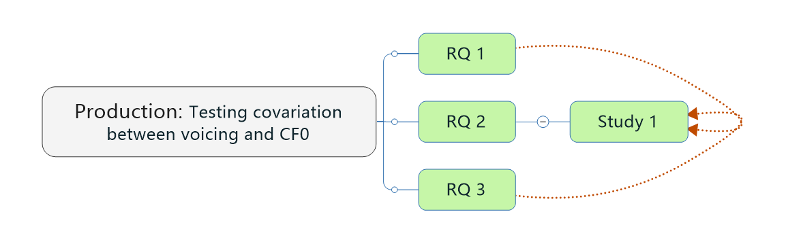
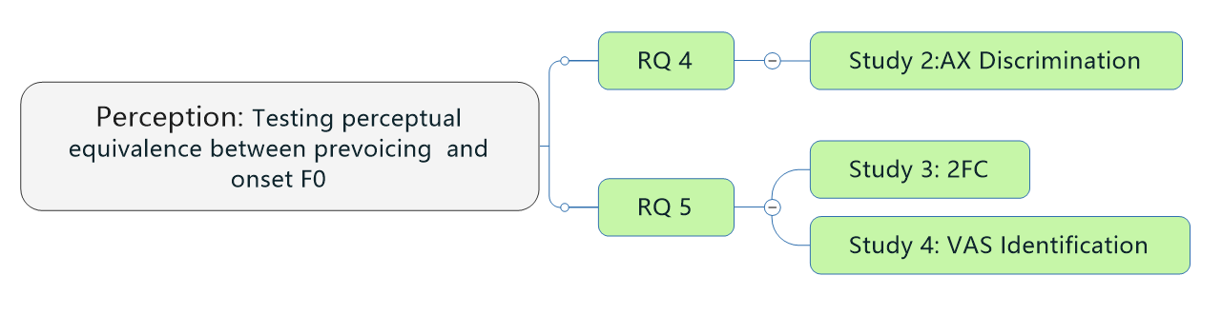
Methodology

Slide 9
Study 1
Participants
11 native speakers of French (9 women+2 men)
Age (median=21, mean=21, SD=1.5)
Materials & Procedures
Read 72 mono-& disyllabic French lexical items with /p,b,m/onsets

Slide 10
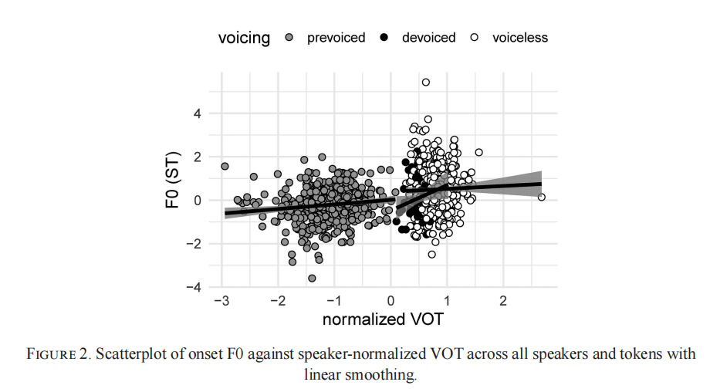
Study 1- Analysis
(Gao & Kirby, 2024)

Slide 11
Study 1- Results
RQ1: Does VOT covary with onset F0 within the voiced and/or voiceless category?
VOT has at best a weakly positive correlation with onset F0 within both voiced and voiceless categories
RQ2: Does VOT covary with onset F0 across the voiced and voiceless categories?
Same as across categories
RQ3: Are voiced plosives that are devoiced followed by a lower onset F0 than those that are typically prevoiced?
Devoiced plosives are not produced with a lower onset F0 than prevoiced plosives

Slide 12
Study 2 – AX Discrimination
Participants
115 native speakers of Metropolitan French
Age >=18
Materials
All stimuli——Ca syllables (C – labial plosive)
Syllables were created with 2 crossed parameters:
4 levels of VOT：-100， -60，-40， 0ms
2）2 levels of onset F0： 90，130Hz
Stimuli pairs were organized according to Condition & Ambiguity

Slide 13
Study 2 – AX Discrimination
Condition
 | Characteristics | VOT | Onset F0 | Example
(A0) Control | Sharing identical | same | same | VOT (−100, −60, −40, or 0 ms) onset F0 (90 or 130 Hz)
(A1) VOT-only | Differed only in VOT | by 60 ms | same | VOT (−100 vs. −40 ms, or −60 vs. 0 ms onset F0 (90 or 130 Hz).
(A2) Additive | The cues were expected to reinforce each other to increase the perceived difference | Longer prevoicing vs. Shorter or no prevoicing | Low vs. Flat | −100 ms VOT with 90 Hz onset F0 vs. −40 ms VOT with 130 Hz onset F0
(A3) Canceling | The cures were expected to trade with each other, canceling out the perceived difference | Longer prevoicing vs. Shorter prevoicing | Flat vs. Low | −100 ms VOT with 130 Hz onset F0 vs. −40 ms VOT with 90 Hz onset F0

Slide 14
Study 2 – AX Discrimination
Ambiguity of prevoicing
Design to examine whether the weight of the F0 cue differed depending on the ambiguity of the primary cue, VOT.
In terms of VOT, 2/3 of the stimuli pairs were clearly within the voiced category (sharing a VOT of −100, −60, or −40 ms), while 1/3 were defined as ambiguous (sharing a VOT of 0 ms)

Slide 15
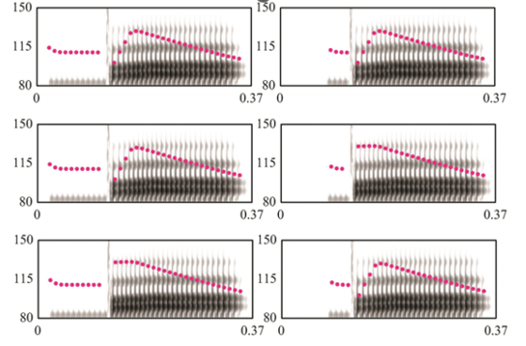
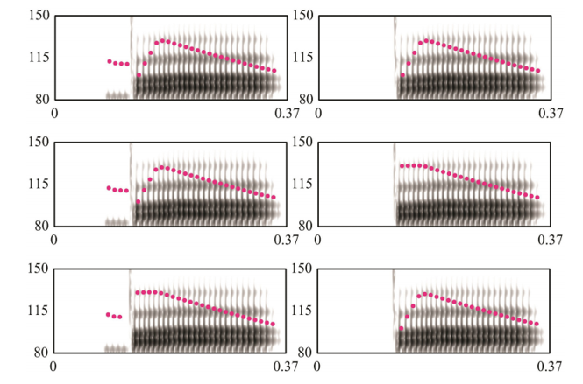
Study 2 – AX Discrimination
Ambiguity of prevoicing
Figure 3. Illustrations of the 3 conditions for stimuli pairs where both are unambiguously /b/ in terms of VOT (Gao & Kirby, 2024)
Figure 4. Illustrations of the 3 conditions for stimuli pairs where one stimulus is ambiguous between /p/ and /b/ in terms of VOT (Gao & Kirby, 2024)

Slide 16
Study 2 – AX Discrimination
Prediction
If prevoicing and low onset F0 are perceived as equivalent across the stimulus space,
i）Discrimination accuracy in the additive condition should be greater than in the VOT-only condition, which should in turn be higher than in the canceling condition: additive > VOT-only > canceling
ii) This pattern should hold regardless of the ambiguity of prevoicing.
In contrast, if listeners discriminate the stimuli pair based on their acoustic (dis)similarity, we expect the discrimination accuracy to follow the order: additive = canceling > VOT-only

Slide 17
Study 2 – AX Discrimination
Procedure
Presented with 2 stimuli on each trial to identify whether sounded identical or different
Interstimulus interval (ISI) -330ms
Intertrial interval -700ms
Time-out - 2.5s
Training phase –twice
Entire session- 20~30min
After experiment – an exit survey about (i.e. language, education, music-related) background

Slide 18
Study 2 – Analysis
Data
114 Listeners (83 women & 31 men)
Age: 18-61 (median=28, mean=32, SD=12)
Discrimination accuracy (d’scores)
d′ was calculated for each participant, based on hit vs. miss responses to different stimuli pairs, and false alarm vs. correct rejection responses to identical stimuli pairs.

Slide 19
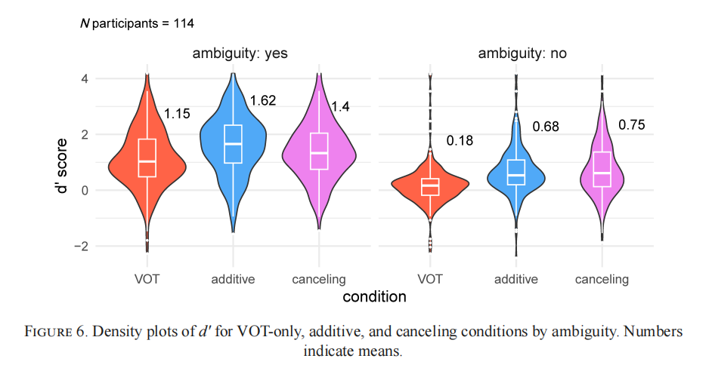
Study 2 – Analysis
(Gao & Kirby, 2024)

Slide 20
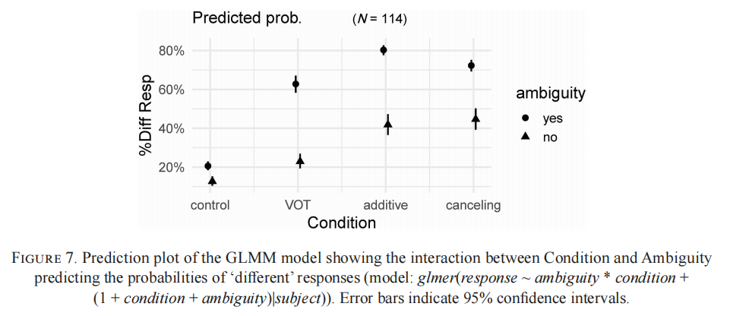
Study 2 – Analysis
(Gao & Kirby, 2024)

Slide 21
Study 2- Results
For ambiguous stimuli pairs
additive > canceling >VOT-only
For unambiguous stimuli pairs
Canceling = additive > VOT-only
RQ4：Is longer prevoicing perceived as equivalent to a lower onset F0 across a wide range of stimulus conditions, whether VOT is ambiguous or not?
Prevoicing trades perceptually with low onset F0 only when VOT is ambiguous, but a strict perceptual equivalence relationship between the two cues is not established when prevoicing is robust.

Slide 22
Study 3 & 4: 2AFC & VAS IDENTIFICATION
 | 2 AFC (Two –Alternative Forced -Choice) | VAS (Visual Analog Scaling)
Purpose | To see where on the VOT continuum onset F0 exerted the most influence on voicing category judgments
Participants | 72 paricipants who completed the AX task
Materials | The same stimuli from the AX task, 4 VOT levels (ranging from -60 ms to 0 ms, stepping in 20 ms intervals) and 2 onset F0 levels (low, flat) | More extensive 6-level VOT continuum (-60 ms to +20 ms) with 3 onset F0 levels (low, flat, high), creating finer gradation along the VOT and F0 dimensions
Procedures | Each participant listened to a stimulus and then selected one of two response options | Participants used a slider on a continuous scale anchored by “pa” on one end and “ba” on the other

Slide 23
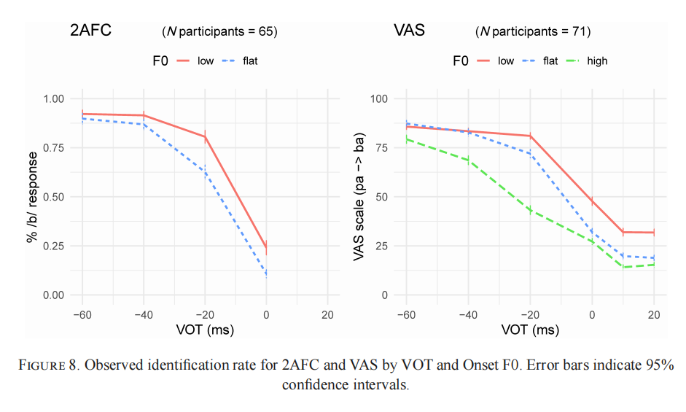
Study 3 & 4 – Analysis
(Gao & Kirby, 2024)

Slide 24
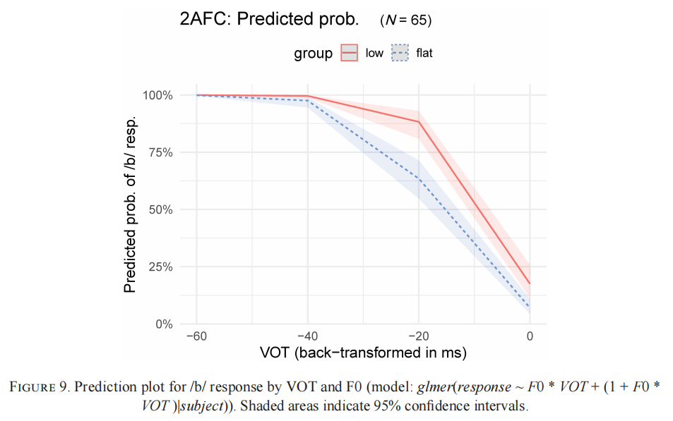
Study 3 & 4 – Analysis
(Gao & Kirby, 2024)

Slide 25
Study 3 & 4- Results
RQ5：Does onset F0 affect voicing categorization along the entire VOT continuum, and not only at the voiced-voiceless boundary?
Onset F0 has the greatest influence around the category boundary, which is estimated to lie between −20 and 0 ms. In addition, onset F0 affects voicing categorization especially when VOT is ambiguous, or when VOT and F0 are conflicting. The effect of onset F0 is not evenly distributed along the entire VOT continuum.

Slide 26
Conclusion
Rather than an inverse correlation in production, we found at best a weakly positive correlation between the extent of prevoicing and onset F0.
Rather than perceptual equivalence across the stimulus space, we found that the cue trading between prevoicing and onset F0 operates especially at the voiced-voiceless boundary.
The phonologization of CF0 seen in‘tonogenetic’ sound changes is driven not by an articulatorily based perceptual equivalence relation, as in the coarticulation of VN sequences. Instead, spontaneous devoicing of onsets creates an ambiguity in voicing categorization that redirects listener attention to the secondary CF0 cue.
Over time, listeners may gradually come to upweight CF0 for lexical disambiguation and subsequently such a perception pattern will lead to establish phonologization.

Slide 27
References
Beddor, Patrice Speeter. 2009. A coarticulatory path to sound change. Language 85. 785–821. DOI: 10.1353/lan.0.0165.
Beddor, Patrice Speeter. 2023. Advancements of phonetics in the 21st century: Theoretical and empirical issues in the phonetics of sound change. Journal of Phonetics 98:101228. DOI: 10.1016/j.wocn.2023.101228.
Coetzee, Andries W.; Patrice Speeter Beddor; Kerby Shedden; Will Styler; and Daan Wissing. 2018. Plosive voicing in Afrikaans: Differential cue weighting and tonogenesis. Journal of Phonetics 66.185–216. DOI: 10.1016/j.wocn.2017.09.009
Gao, Jiayin, and James Kirby. 2024 Laryngeal contrast and sound change: The production and perception of plosive voicing and co-intrinsic pitch. Language 100 (1): 124-158. DOI:10.1353/lan.2024.a922001.
Kirby, James P., and D. Robert Ladd. 2016. Effects of obstruent voicing on vowel F0: Evidence from ‘true voicing’ languages. The Journal of the Acoustic Society of America 140.2400–2411. DOI: 10.1121/1.4962445.
Macmillan, Neil A., and C. Douglas Creelman. 2005. Detection theory: A user’s guide. 2nd edn. London: Routledge.
Ohala, John J. 1989. Sound change is drawn from a pool of synchronic variation. Language change: Contributions to the study of its causes, ed. by Leiv E. Breivik and Ernst Håkon Jahr, 173–98. Berlin: De Gruyter. DOI: 10.1515/9783110853063.173.
Yu, Alan C. L. 2021. Toward an individual-difference perspective on phonologization. Glossa: a journal of general linguistics 6(1):14. DOI: 10.5334/gjgl.661.

Slide 28
Thank You !

